Slide 1
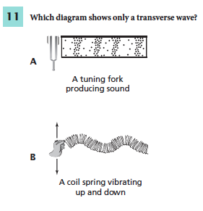
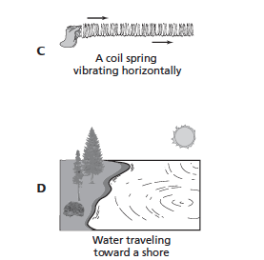
1/17/2017
You must explain why your answer is correct.
Explain what type of wave the other three answer are.
Use the index of your book to help you.
Notes:
c

Slide 2
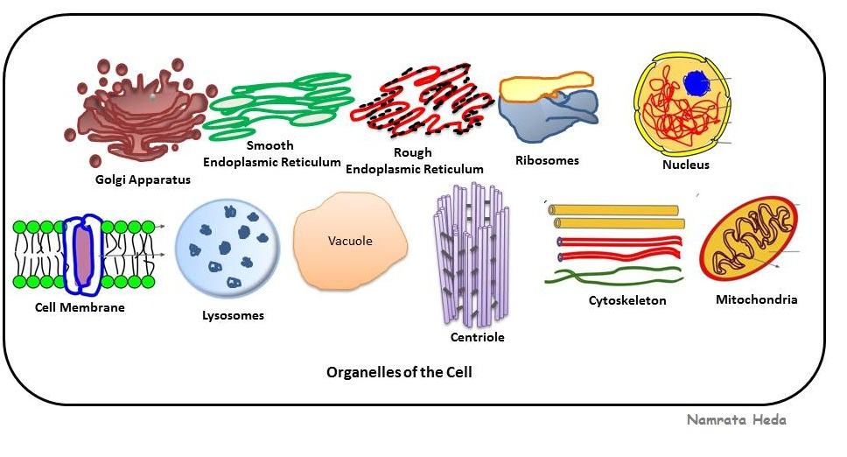
Cells Structure
SPI 0707.1.1 Identify and describe the function of the major plants and animal cell organism

Slide 3
Why is it important?
What you will Learn
Evaluate the functions of each part of a cell.
Explain how important a nucleus is in a cell.
If you know how organelles function, it’s easier to understand how cells survive.

Slide 4
Essential Questions
Why are the all the parts of a cell important?
https://www.youtube.com/watch?v=-zafJKbMPA8 3:09 minutes

Slide 5
Common Cell Traits
What are cells? View video
https://www.brainpop.com/science/cellularlifeandgenetics/cells/
Common Cell Traits
A cell -
is smallest unit that is capable of performing life functions.
have an outer covering called a …
cell membrane -made up of one or more layers of linked molecules. (Skin)
Inside every cell is a gelatin-like material called …
cytoplasm - hereditary material that controls the life of a cell. (Blood)

Slide 6
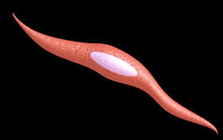
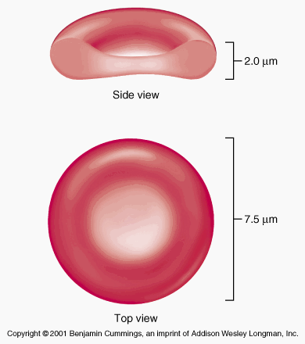
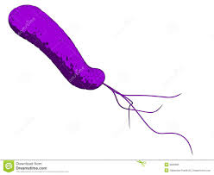
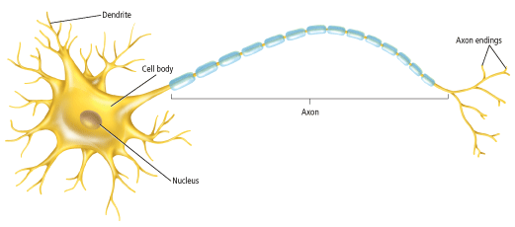
Common Cell Traits
Comparing Cells
Cells come in many sizes.
Cell’s shape might tell about its function.
Nerve-send/receives impulses from other cells but cannot change shape.
Muscle and some blood cells can change shape.
Plant stems – have long hollow cells with openings at their ends. Also, carry food and water throughout the plant.
Cell Types
Two groups of cells
Prokaryotic -no membrane to bound structure inside the cell.
Eukaryotic – membrane bound structures
https://www.youtube.com/watch?v=ruBAHiij4EA 5:52 minutes
Using the video, write the similarities and differences between the two cells.

Slide 7
Prokaryotic vs. Eukaryotic
The distinction between prokaryotes and eukaryotes is considered to be the most important distinction among groups of organisms. Eukaryotic cells contain membrane-bound organelles, such as the nucleus, while prokaryotic cells do not. Differences in cellular structure of prokaryotes and eukaryotes include the presence of mitochondria and chloroplasts, the cell wall, and the structure of chromosomal DNA.
Prokaryotes were the only form of life on Earth for millions of years until more complicated eukaryotic cells came into being through the process of evolution.

Slide 8
Eukaryotic

Slide 9
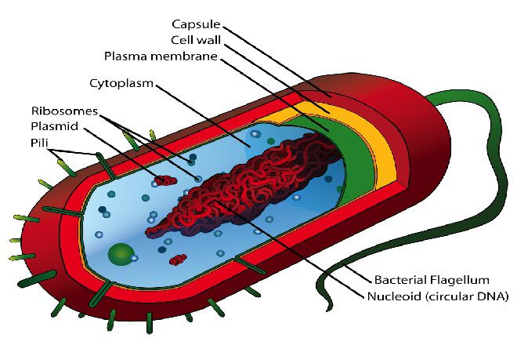
Prokaryotic

Slide 10
Listen and Take Notes
https://www.youtube.com/watch?v=g4L_QO4WKtM
Note the cell structure and function of each part. 7: 12 minutes

Slide 11
Quiz Time
https://www.brainpop.com/science/cellularlifeandgenetics/cells/
Use whiteboards, eraser and markers

Slide 12
Reflection
What have I learned about cells?
What do I still wonder about cells?
I still confused about ________________

Slide 13
Let’s Create
Use what you know about cells to create a poster/visual representation of the cell.
You and your table members will complete a plant and animal cell poster model
Label the cells and explain its function using an analogy or comparison of organelles using everyday items, jobs, location, etc.

