Slide 1
Bell Work
Clear off your area to work on your rock cycle poster.
Sit quietly while I pass out your items.
Notes:
http://www.youtube.com/watch?v=jVd-SPZLh5s

Slide 2
The Rock CyCle
SPI 0707.7.2 Label a diagram that depicts the three different rock types.
SPI 0707.7.3 Identify the major processes that drive the rock cycle.

Slide 3
What You Will Learn
The journey of a rock

Slide 4
Essential Questions
What does the journey of a rock look like?

Slide 5
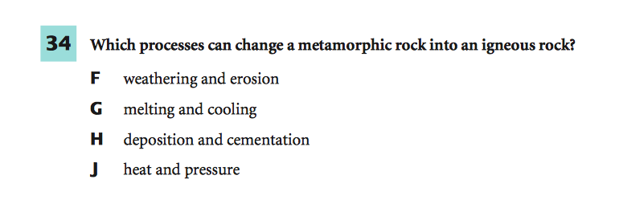
What Mastery Looks Like
Notes:
34 - G

Slide 6
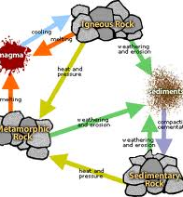
Rock Cycle
The rock cycle describes how different kinds of rocks are related to one another.
Also, how each one changes from one type to another.
Notes:
SHOW VIDEO!

Slide 7
The Journey of a Rock
First, lava oozes to the surface and cools.
Igneous Rocks
Wind, Rain and Ice wear away at rock-breaking off small pieces.
Sediments
Streams & rivers carry sediment to the ocean and it piles up. It compresses together due to weight and mineral rich water seeps it and glues it
Sedimentary rock
Sedimentary rock is buried and pressure and heat inside Earth changes it
Metamorphis Rock.

Slide 8
1, 2, or 3 – Over Your Heart
If you feel great about the Rock Cycle, give me a 1.
If you feel okay about the Rock Cycle, but you feel like you need more guidance, give me a 2.
If you are completely confused, give me a 3.

Slide 9
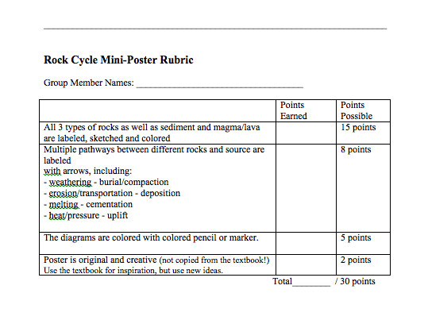
1 and 2 - Create a Rock Cycle diagram! 3 – I’m going to help you get started.

Slide 10
The Rock Cycle
SPI 0707.7.2 Label a diagram that depicts the three different rock types.
SPI 0707.7.3 Identify the major processes that drive the rock cycle.

