Slide 1
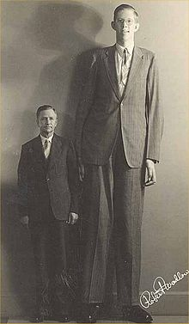
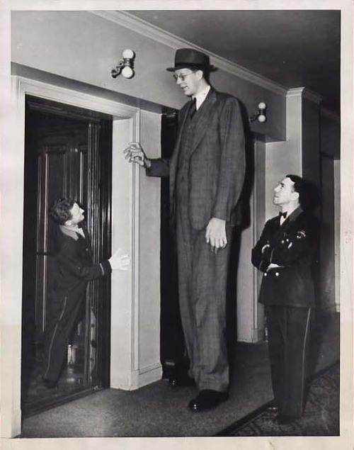
Robert Wadlow – the tallest man in world
Why do you think he didn’t stop growing?
Notes:
Instructional Approach(s): The teacher should pose the question to the students. Allow students to discuss as a class or in small groups. Do not spend more then 3-4 minutes total discussing the slide

Slide 2
Essential Question: How do major organ systems work together in living organisms?
Standards:
S7L2d. Explain that tissues, organs, and organ systems serve the needs cells have for oxygen, food, and waste removal.
S7L2e. Explain the purpose of the major organ systems in the human body (i.e., digestion, respiration, reproduction, circulation, excretion, movement, control and coordination, and for protection from disease).
Notes:
Instructional Approach(s): The teacher should review the essential question and the standards that align to the essential question

Slide 3
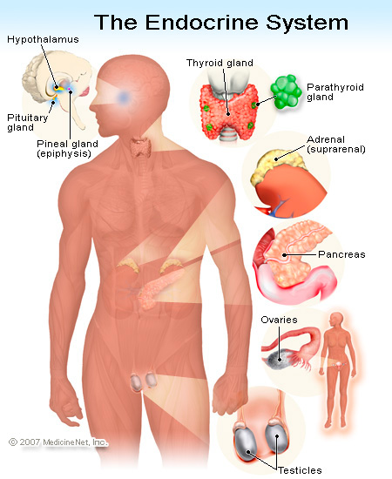
Endocrine/Integumentary System
Notes:
Instructional Approach(s): The teacher should use the slide to introduce the Endocrine System

Slide 4
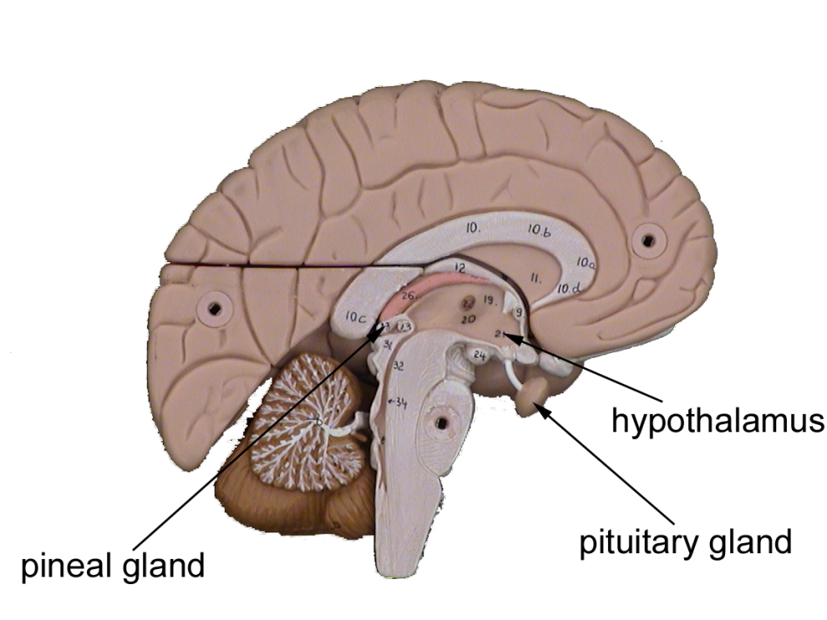
Endocrine System
Role: Controls the conditions in your body by making and releasing chemicals that are transported throughout the body.
Notes:
Instructional Approach(s): The teacher should present the information on the slide while the students record the role of the Endocrine System on their graphic organizer sheet

Slide 5
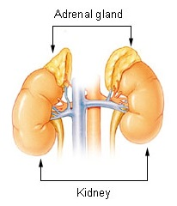
Glands
Groups of specialized cells in the body that produce and release hormones
Notes:
Instructional Approach(s): The teacher should present the information on the slide while the students record the important information about Glands on their graphic organizer sheet

Slide 6
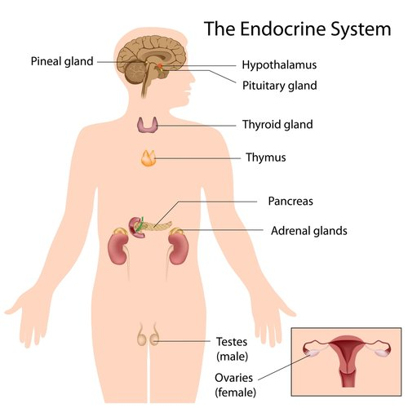
Glands of the Endocrine System
Notes:
Instructional Approach(s): The teacher should use the image to illustrate the various glands of the Endocrine System. The teacher may ask the students to record a few examples of glands on their graphic organizer sheet

Slide 7
Hormones
Chemicals that are made in one organ, travel through the blood, and produce an effect in other parts of the body.
Name | Where Produced | Produces response in
Growth Hormones | Pituitary Gland | All Body Cells
Adrenaline | Adrenal Gland | Heart, Lungs, Stomach, Intestine, Glands
Insulin | Pancreas | All Body Cells
Notes:
Instructional Approach(s): The teacher should introduce the information on the slide while the students record important information about Hormones on their graphic organizer sheet. The teacher may ask the students to record a few examples of hormones on their graphic organizer sheet

Slide 8
Examples of the Hormone Adrenaline: Watch the video clip and describe what may be happening in the person’s body at the time.
http://www.youtube.com/watch?v=yLcjhgC7xxs
Notes:
Instructional Approach(s): The teacher should show the video clip and discuss what the people may be feeling and what might be happening within their bodies. The people in the video may be feeling scared, excited, nervous, sick, etc. All of the feelings are occurring because of the release of the hormone adrenaline into their system

Slide 9
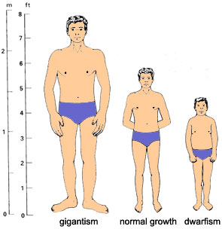
Examples of too much or too little Growth Hormone:
Notes:
Instructional Approach(s): The teacher should use the information on the slide to illustrate examples of too much or too little growth hormone

Slide 10
Endocrine System Overview Video
http://www.youtube.com/watch?v=tN78hYn3ehc
Notes:
Instructional Approach(s): The teacher should show the video clip reviewing the Endocrine System

