Slide 1
November 4, 2014
1. Use textbook to
support your answer.
2. Write down page number where information is found.
Notes:
a

Slide 2
Chapter 9 Section 3 Day 1
SPI 0707.7.2 Label a diagram that depicts the three different rock types.
SPI 0707.7.3 Identify the major processes that drive the rock cycle.

Slide 3
Agenda
We will review for your science quiz that is coming up tomorrow.
We will preview and start discussing metamorphic rock.
Remember, you get five points for having the flow chart correctly completed and stapled to your quiz.
We will complete the flow chart after we review for our quiz.

Slide 4
Review
Complete p.276 1-5.
Complete p. 283 1-4.
Be ready to discuss.
Use your book and notes to help you.

Slide 5
Review Answers p. 276
Explain the difference between a mineral and a rock. Name five common rock-forming minerals.
Minerals: Naturally occurring, inorganic solid with a definite composition and orderly internal atomic arrangement. Rock: usually comprised of two or more minerals. Rock-forming minerals include quartz, feldspar, calcite, gypsum, and halite, among others.
List five properties that are used most commonly to identify minerals.
Color, luster, streak, hardness, cleavage, magnetism

Slide 6
Review Answers p. 276
Describe an event that must occur in order for diamond to reach Earth’s surface. Where in Earth is diamond formed?
Diamonds form in Earth’s mantle under conditions of high pressure. Diamonds erupt to the surface via volcanic eruptions.
Describe the steps of mining, smelting, and refining that are used to extract minerals or elements from ores. When is a mineral considered to be an ore?
Minerals first are extracted from Earth by mining. Mined material can be melted and desired substances separated from unwanted material during smelting. Refining purifies the desired mineral even more. Earth materials are considered ores when they can undergo expensive mining and refinement processes and still yield a profit.
Would you want to live close to a working gold mine? Explain.

Slide 7
Review p. 283
Compare/Contrast the ways in which extrusive and intrusive igneous rocks are formed.
Extrusive igneous rocks cool quickly from lava, producing no or small crystals. Intrusive igneous rocks cool slowly from magma, producing large crystals.
Diagram how each of the three kinds of sedimentary rock forms. List one example of each kind of rock: detrital/clastic, chemical, and organic
Detrital rocks – pieces of other rocks, sandstone
Chemical rocks – precipitation of minerals from solution, rock salt
Organic rocks – from the remains of once-living things, coal

Slide 8
Review p. 283
List in order from smallest to largest the grain sizes used to describe detrital rocks.
clay, silt, sand, gravel
Why do igneous rocks that solidify underground cool so slowly?
The surrounding rock insulates the cooling magma.

Slide 9
Quiz
Your quiz is tomorrow.
Don’t forget to study!
Study Guide

Slide 10
Metamorphic Rock
https://www.youtube.com/watch?v=1oQ1J0w3x0o
Flow Chart
You must have this in your hands tomorrow to get the bonus points.

Slide 11
What You Will Learn
What metamorphic rock is
How metamorphic rock is formed

Slide 12
Essential Questions
What is metamorphic rock?
How is it formed?

Slide 13
What Mastery Looks Like
Which number represents metamorphic rock?

Slide 14
New Rock from Old Rock
Physical changes on & within Earth constantly change rocks.
Examples:
Weathering and Erosion = Sedimentary Rock
High Temperature with Molten Rock = Igneous
Pressure and temperature increase as rocks are compressed or buried deeply.
This leads to change in chemistry and grain sizes of rock. (without melting it)

Slide 15
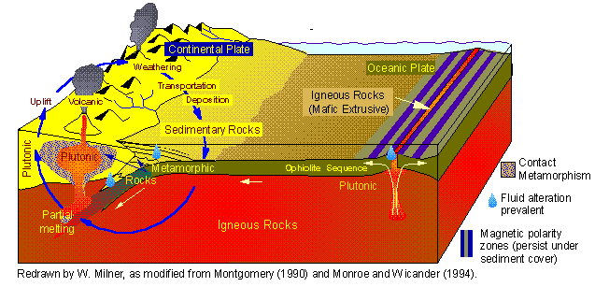
New Rock from Old Rock
These changes happen where Earth’s tectonic plates collide to form mountains.
This change in rocks takes MILLIONS of years.
Existing rocks are cooked when magma is forced upward in Earth’s crust – changing the mineral crystals.

Slide 16
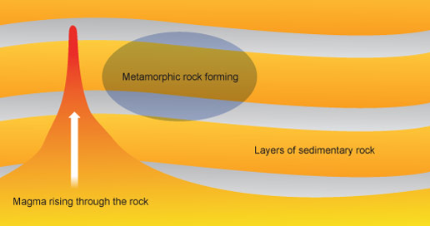
Metamorphic Rock
The term “metamorphic” means “to change form.”
Process
New rocks form thousands of meters below Earth’s surface where temperatures and pressures are…
HIGH!
New rocks are formed when existing rock is heated and squeezed, but not melted.
Rocks look different, have recrystallized and have been chemically changed.

Slide 17
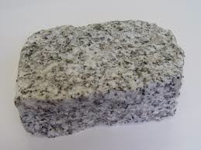
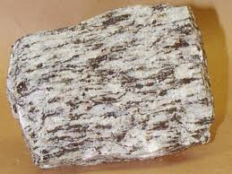
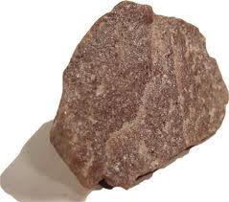
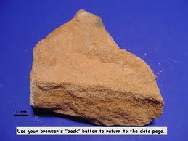
Examples of Changed Rocks
Granite
Gneiss
Sandstone
Quartzite

Slide 18
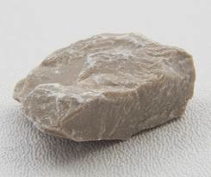
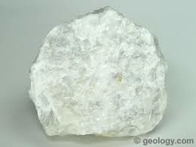
Examples of Changed Rock
Limestone
Marble

Slide 19
Metamorphic Rock
Can any rock become metamorphic rock?
Think about it. Come with your answer tomorrow.

Slide 20
Exit Ticket
Identify the process that shows metamorphic rock.

