Slide 1
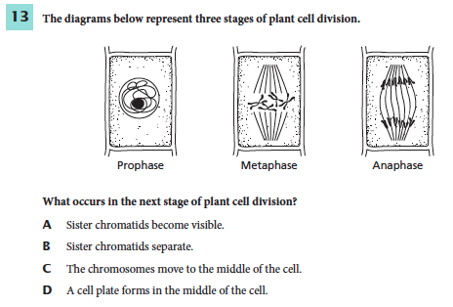
1. Use textbook to
support your answer.
2. Write down page number where information is found.
Notes:
d

Slide 2
Chapter 9 Day 2 Section 1
SPI 0707.7.1 Use a table of physical properties to classify minerals.

Slide 3
What You Will Learn
The properties used to identify minerals
Which properties are the most useful

Slide 4
Essential Questions
How are minerals identified?
What types of properties are used to identify minerals?
What are the different properties used?

Slide 5
What Mastery Looks Like
Explain why streak often is more useful for mineral identification than color.

Slide 6
Foldable
Divide your paper into 8 sections.
Label each section with the properties on the next page.

Slide 7
Properties of Minerals
Crystal Patterns
Cleavage and Fracture
Color
Streak
Luster
Special Properties
Hardness (tomorrow)
Specific Gravity (tomorrow)
Brain Pop

Slide 8
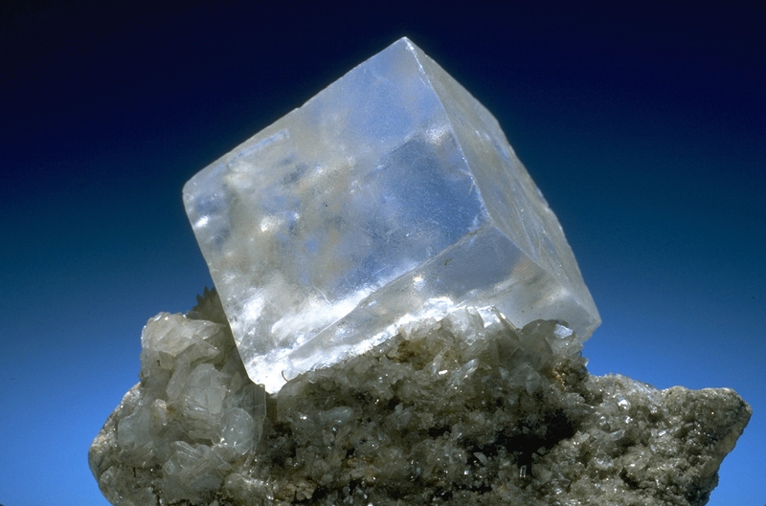
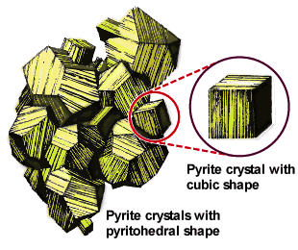
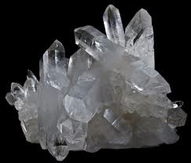
Crystal Structure
All minerals are made of orderly patterns.
Some minerals form crystals if there is time and room for the crystals to form.
The crystal pattern of a mineral is controlled by the internal arrangement of the atoms that make up the mineral.
Some examples of these crystal structures are quartz which has a hexagonal (six-sided) crystal and halite which has a cubic crystal.
Sometimes crystals have smooth growth surfaces called crystal faces. EX. Pyrite Figure 3 pg. 270
Halite
Quartz

Slide 9
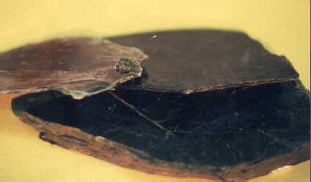
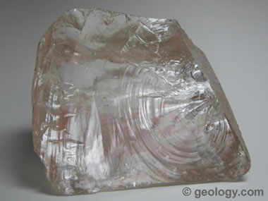
Cleavage and Fracture
Cleavage
If a mineral breaks along flat, smooth surfaces it shows cleavage. Cleavage can be in one, two or three directions. (Examples are on the next slide.)
Fracture
If a mineral breaks along irregular rough surfaces it shows fracture. Quartz shows a special type of fracture called concoidal (shell-like) fracture.
Cleavage in Mica
Which shows cleavage? Which shows fracture?
Transparent "rock crystal" quartz. This specimen shows the conchoidal fracture (fracture that produces curved surfaces) that is characteristic of the mineral.

Slide 10
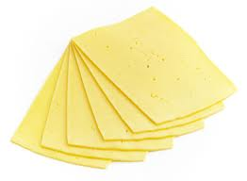
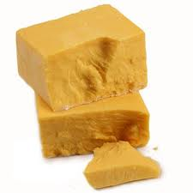
Cleavage and Fracture
Cleavage is the tendency of a mineral to break along flat surfaces.
(Sliced Cheese)
Fracture is the tendency of a mineral to break into irregular pieces.
(Chunks of Cheese)

Slide 11
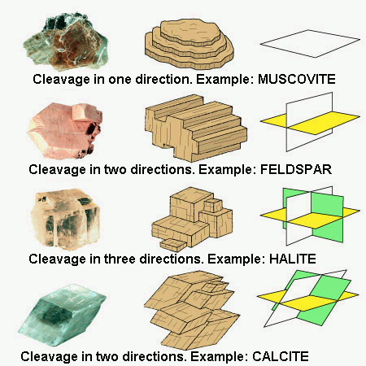
Cleavage and Fracture

Slide 12
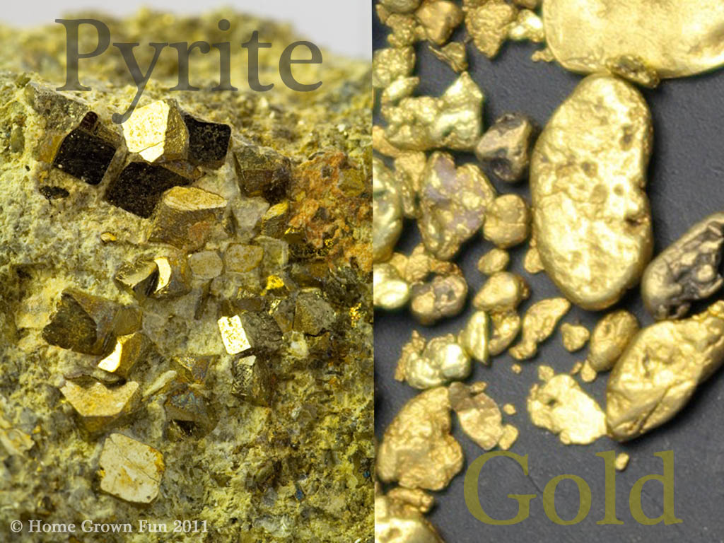
Color
Color is the first thing noticed when viewing a mineral.
People are attracted to mineral colors.
Is it always the best way to identify? Why or Why not?
Think about Pyrite aka “Fool’s Gold.”
Some minerals share colors.

Slide 13
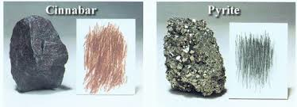
Streak
Streak is closely related to color, but is a different property because the color of the mineral may be different than the color of the streak.
Streak is actually the color of the powder of a mineral. It is called streak because the proper way to test for streak is to rub a mineral across a tile of white unglazed porcelain and to examine the color of the "streak" left behind.
Streak Test

Slide 14
Luster
This is the way a mineral reflects light.
Two major types
Metallic
Shines like metal
Nonmetallic
Pearly, glassy, dull, or earthy
What other things (not minerals) are identified this way?

Slide 15
Hardness
Resistance to being scratched (more tomorrow)

Slide 16
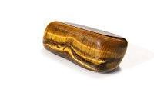
Special Properties
What kind of special properties might a mineral have?
magnetism
chatoyancy
fluorescence
odor
burn test
conductivity
Notes:
The pic is of tiger’s eye showing chatoyancy.

Slide 17
Exit Ticket
Explain why streak often is more useful for mineral identification than color.
Notes:
Because streak is a more accurate illustration of the mineral’s color, streak is a more reliable property of minerals than color for identification.

