Slide 1
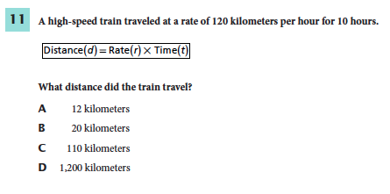
1. Use textbook to support your answer.
2. Write down page number where information is found.
Notes:
D
F

Slide 2
Chapter 9 Lesson 1 Day 1
SPI 0707.7.1 Use a table of physical properties to classify minerals.

Slide 3
What You Will Learn
To Identify the difference between a mineral and rock
What a mineral is and how it is formed
That minerals have properties that are used to classify minerals

Slide 4
Essential Questions
What is a rock?
What is a mineral?
How do minerals form?
How are minerals classified?

Slide 5
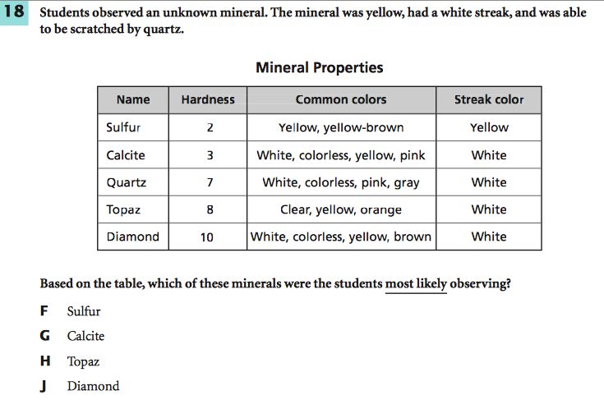
What Mastery Looks Like

Slide 6
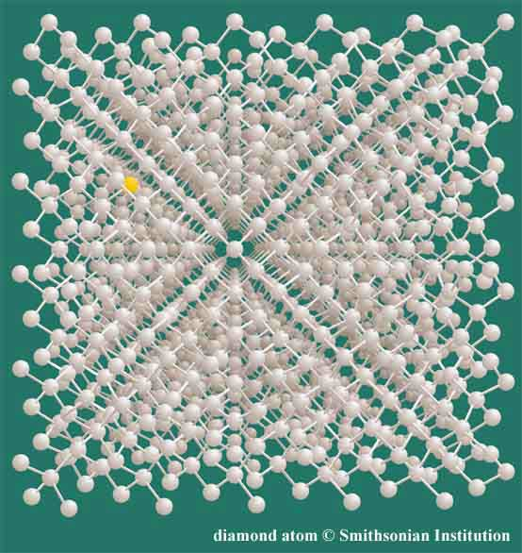
What is a mineral?
Inorganic = not from living matter
Mineral Video (10:00)
A mineral is an inorganic, solid material found in nature.
Most minerals occur naturally as crystals. Every crystal has an orderly, internal pattern of atoms, with a distinctive way of locking new atoms into that pattern to repeat it again and again.
Chemical makeup and arrangement is unique to each mineral.
Rocks: made of 1 or more minerals
The colored atom in the upper left corner is an impurity in the structure of this diamond.
Impurities such as this cause the different colors of diamonds.

Slide 7
How do minerals form?
From melted rock inside Earth (magma)
As magma cools, atoms combine in orderly fashions
Also form from magma that reaches Earth’s surface (lava)
Evaporation
Salt will appear when seawater evaporates
Precipitation
Water can hold only so much
Any extra that can’t be held in the water, separates and falls out as a solid.

Slide 8
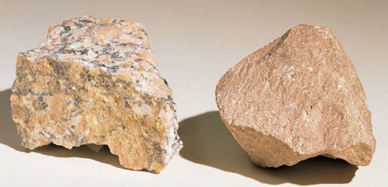
How does cooling affect minerals?
When magma cools, crystals form because the solution is super-saturated with respect to some minerals.
If magma cools QUICKLY, the crystals don’t have much time to form, so they are very __________.
If magma cools SLOWLY, the crystals have enough time to grow and become _________.
small
large
Granite, a slow-cooled igneous rock with the same minerals and composition as the fast-cooled yet fine-textured Rhyolite.

Slide 9
Preview
Tomorrow, we will dive deeper into the properties of minerals.

Slide 10
What’s the answer?

Slide 11
Read!
P. 268 - 269
What is a Mineral?
Minerals Defined
How Do Minerals Form?
Formation clues
What did we not take notes on here? Put it in your notes.

Slide 12
Exit Ticket
Write one new thing you learned about rocks or minerals today.
How will you use the information you learned today in real life?

