Slide 1
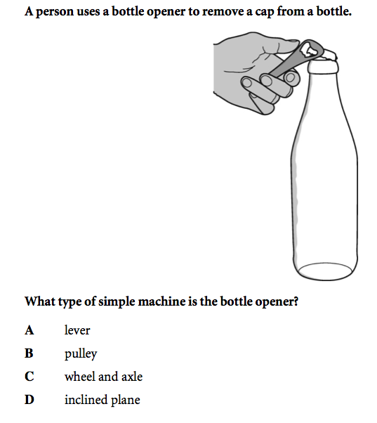
Bell Work
Notes:
A

Slide 2
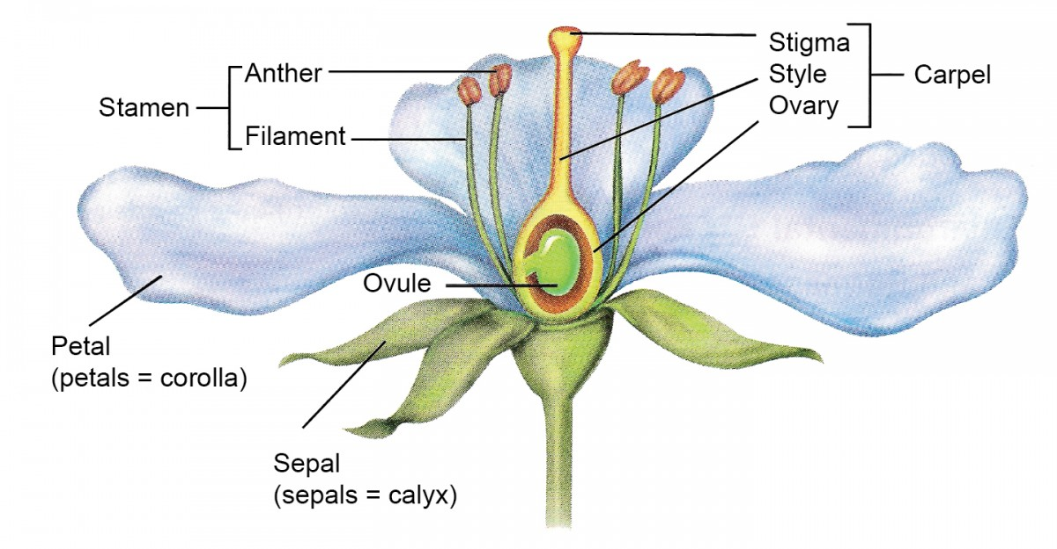
Introduction to Plant Reproduction
Demonstrate an understanding of sexual reproduction in flowering plants.
Classify organisms according to whether they reproduce sexually or asexually.
https://www.youtube.com/watch?v=JumEfAbjBjk#t=15

Slide 3
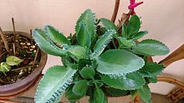
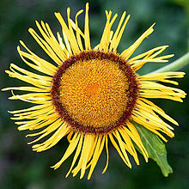
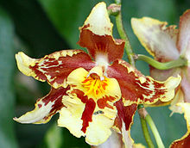
What You’ll Learn
Distinguish between the two types of plant reproduction.
Describe the two stages in a plant’s life cycle.

Slide 4
Why it’s Important
Hydrangeas root easily from stem cuttings.
You can grow new plants without using seeds.

Slide 5
Types of Reproduction
Like humans, plants can _________ and make similar copies of themselves.
While humans only have ____ type of reproduction, most plants reproduce in ____ different ways.
http://www.brainpop.com/science/cellularlifeandgenetics/plantgrowth/
Notes:
Reproduce
One
Two

Slide 6
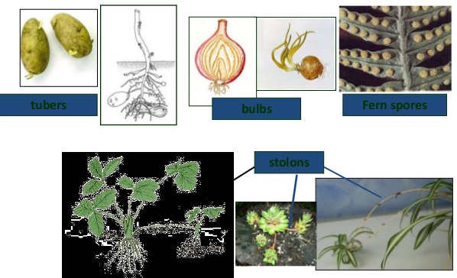
Asexual Reproduction
All offspring are genetically identical to the parent.
Stolons and Runners (grasses), Tubers (potatoes), Spores (ferns and mosses), Bulbs (onions)

Slide 7
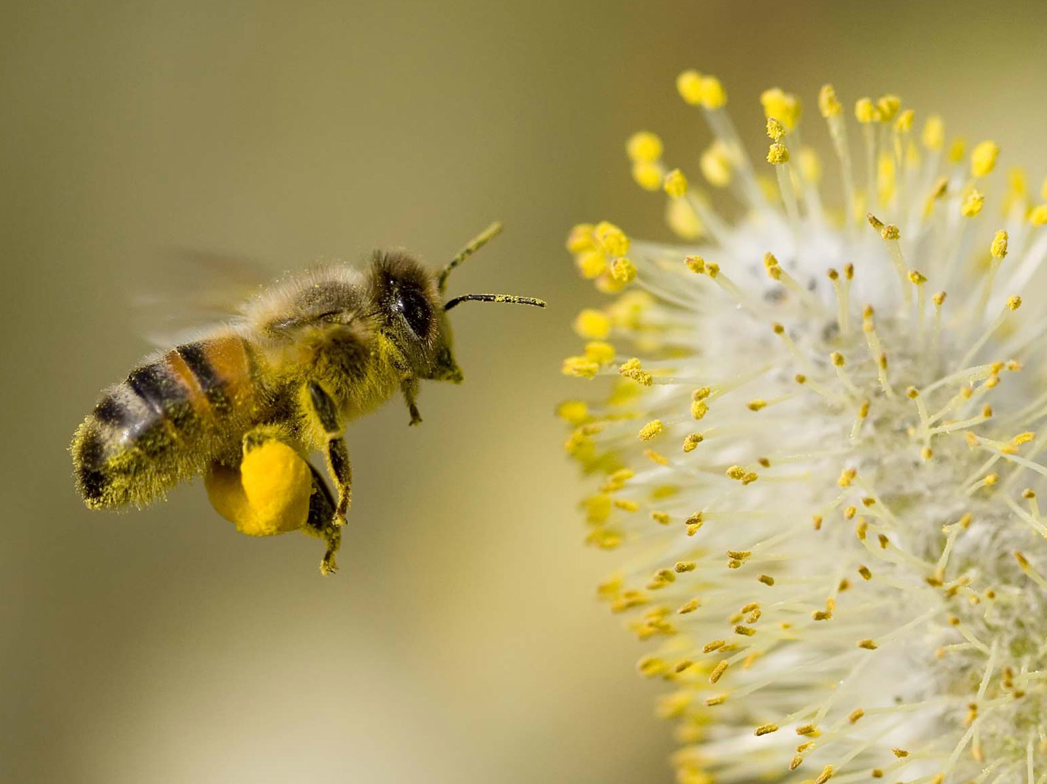
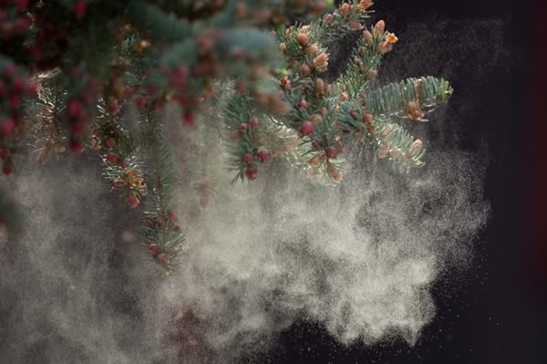
Sexual Reproduction
An important event in sexual reproduction is _____.
Fertilization occurs when a ______ and ______ combine to produce the first cell of the new organism, the zygote.
How do sperm and egg get together?
In some plants, water and wind help.
For others, insects help bring the sperm and egg together.
Notes:
Fertilization
Sperm
Egg

Slide 8
Reproductive Organs
A plant’s _____ reproductive organs produce eggs.
A plant’s _____ reproductive organs produce sperm.
Depending on the species, these organs can be on the same plant or _____ plants.
If a plant has both organs, it usually can reproduce by itself. Some plants, however, that have both sex organs still must exchange sex cells with other plants of the same type to reproduce.
Notes:
Female
Male
Separate

Slide 9
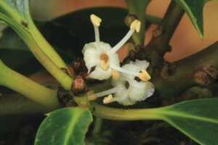
Example
Holly plants are either male or female.
A male-flowering holly bush is necessary in order for female hollies to bear fruit.
You can tell the difference between males and females because only the females produce berries. Also, though both sexes produce clusters of white flowers, the male's flowers have more prominent stamens.
Only one male holly is needed to pollinate three or four females.
Female
Male
Female

Slide 10
Plant Life Cycles
All organisms have life cycles.
Your life cycle started when a sperm and an egg game together to produce the ______ that would grow and develop into the person you are today.
A plant also has a life cycle.
It can start when an egg and a sperm come together, eventually producing a mature plant.
Notes:
Zygote

Slide 11
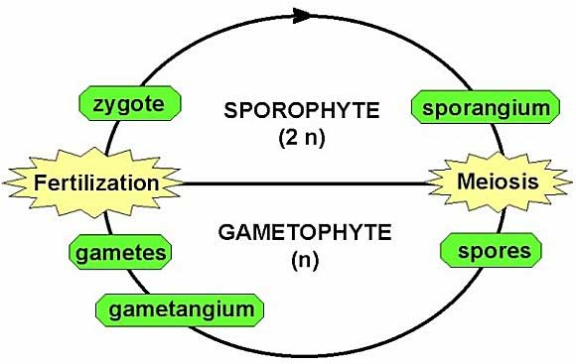
Plant Life Cycle

Slide 12
Two Stages
Gametophyte Stage
Sporophyte Stage
When reproductive organs undergo meiosis and produce haploid cells called spores, the gametophyte stage begins.
Spores divide by mitosis and cell division and form plant structures or an entire new plant made of haploid cells.
Some of these cells undergo mitosis and cell division and form haploid sex cells.
Fertilization begins in the sporophyte stage.
Cells formed in this stage have the diploid number of chromosomes.
Meiosis in some of these cells forms spores, and the cycle repeats.
https://www.youtube.com/watch?v=X4L3r_XJW0I

Slide 13
Exit Ticket
Complete section 1 review.

