Slide 1
Bell Work
You have until 10:30 to finish any of your mitosis stations.
If you finish all of them, read through chapter 6 lesson 2 silently.

Slide 2
Chapter 6 Lesson 2 Part 2
Sexual Reproduction
and
Meiosis
SPI 0707.4.1
Classify methods of reproduction as sexual or asexual.
SPI 0707.1.4
Sequence a series of diagrams that depict chromosome movement during cell division.

Slide 3
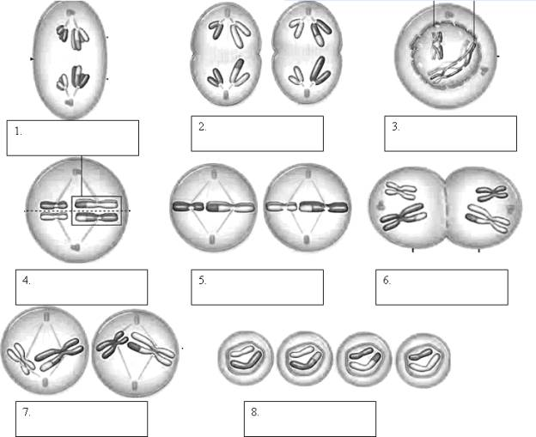
What mastery looks like
Label the following pictures:

Slide 4
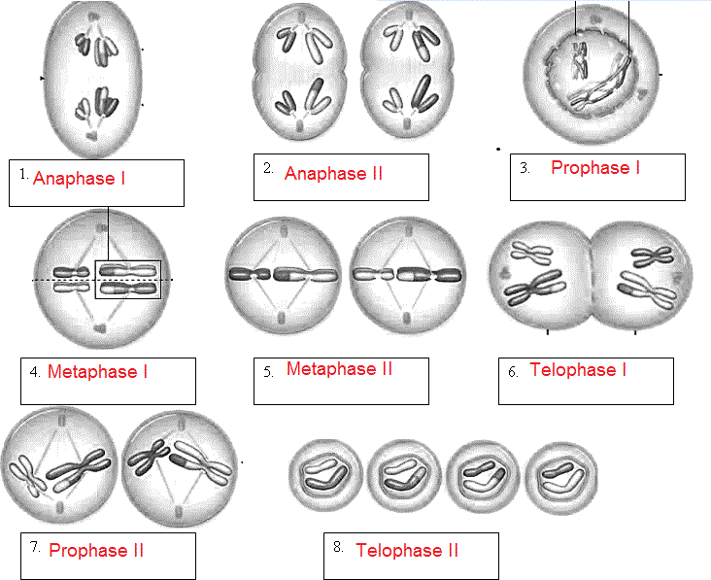
Answers

Slide 5
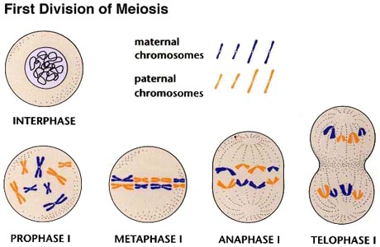
Meiosis and sex cells
During meiosis, two divisions of the nucleus occur.
These divisions are called meiosis I and meiosis II.
Draw these diagrams with the appropriate tab.

Slide 6
Video
Watch this video and take notes with the appropriate tab.
http://highered.mheducation.com/sites/0072495855/student_view0/chapter28/animation__stages_of_meiosis.html

Slide 7
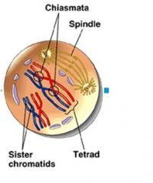
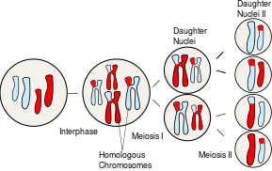
Meiosis 1
Interphase:
the cell replicates its chromosomes
each chromosome has two sister chromatids held together by a centromere
Prophase 1:
chromosomes coil up and a spindle forms
homologous chromosomes come together matched gene by gene forming a tetrad
Crossing Over may occur when chromatids exchange genetic material
this occurs two or three times per pair of homologous chromosomes
Crossing Over results in new combinations of alleles on a chromosomes
Metaphase 1:
the centromere of each chromosome becomes attached to a spindle fiber
the spindle fibers pull the tetrads to the equator of the spindle
homologous chromosomes are lined up side by side as tetrads
A couple of homologous chromosomes are a set of one maternal chromosome and one paternal chromosome that pair up with each other inside a cell during meiosis. These copies have the same genes in the same locations, or loci.

Slide 8
Meiosis I
Anaphase 1:
homologous chromosomes separate and move to opposite ends of the cell
centromeres do not split
this ensures that each new cell will receive only one chromosome from each homologous pair
Telophase 1:
the spindle breaks down and the chromosomes uncoil
the cytoplasm divides to yield two new cells
each cell has half the genetic information of the original cell because it has only one homologous chromosome from each pair

Slide 9
START HERE!!!
This is where Monday’s info starts.

Slide 10
Bell Work
Take out your note-taking sheet. If you don’t have it complete, sign the book.
You have 10 minutes to work on mitosis stations.
If you are done, silently answer the following in your bell work journal.
Give YOUR OWN brief description of what happens during the following stages of the cell cycle:
G1
S
G2
Mitosis
Cytokinesis

Slide 11
Chapter 6 Lesson 2 Part 2
Sexual Reproduction
and
Meiosis
SPI 0707.4.1
Classify methods of reproduction as sexual or asexual.
SPI 0707.1.4
Sequence a series of diagrams that depict chromosome movement during cell division.

Slide 12
What mastery looks like
Label the following pictures:

Slide 13
Answers

Slide 14
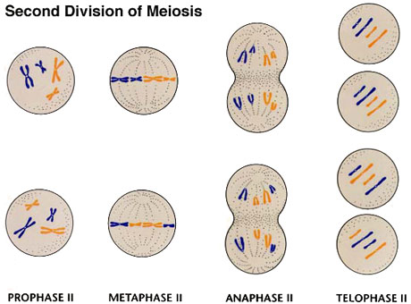
Meiosis and sex cells
During meiosis, two divisions of the nucleus occur.
These divisions are called meiosis I and meiosis II.
Draw these diagrams with the appropriate tab.

Slide 15
Meiosis II
Prophase II:
a spindle forms in each of the two new cells and the fibers attach to the chromosomes
Metaphase II:
the chromosomes are pulled to the center of the cell and line up randomly at the equator
Anaphase II:
the centromere of each chromosome splits -the sister chromatids separate and move to opposite poles

Slide 16
Meiosis II
Telophase II:
nuclei reform
the spindles break down -the cytoplasm divides
identical to mitosis (Meiosis II)
What Meiosis produces:
four haploid sex cells from one original diploid cell
each haploid cell contains one chromosome from each homologous pair
haploid cells will become gametes transmitting genes to offspring

Slide 17
START HERE!

Slide 18
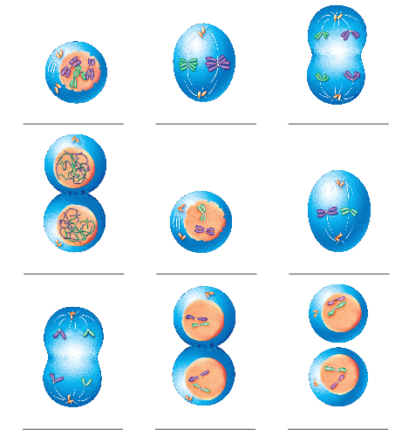
BELL
WORK
Label each stage of meiosis.
3.
1.
2.
6.
4.
5.
7.
9.
8.

Slide 19
Bell Work
Are the cells that begin meiosis haploid or diploid?
Are the cells that begin mitosis haploid or diploid?
Are the cells that end meiosis haploid or diploid?
Are the cells that end mitosis haploid or diploid?

Slide 20
Chapter 6 Lesson 2 Part 2
Sexual Reproduction
and
Meiosis
SPI 0707.4.1
Classify methods of reproduction as sexual or asexual.
SPI 0707.1.4
Sequence a series of diagrams that depict chromosome movement during cell division.

Slide 21
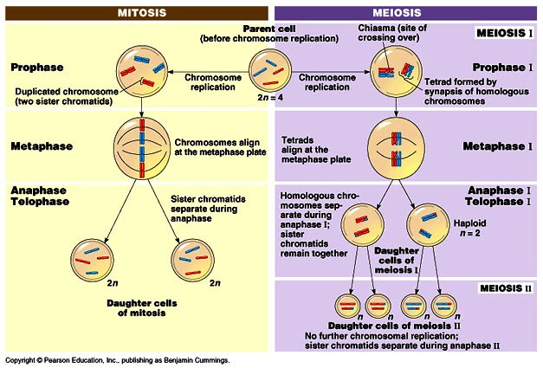
MITOSIS VS MEIOSIS

Slide 22
Meiosis
https://www.youtube.com/watch?v=rB_8dTuh73c

Slide 23
Summary of meiosis
Meiosis I
2 cells form
Meiosis II
Both cells form 2 cells
Each of the cells has one-half
the number of chromosomes in
its nucleus that was in the original
Nucleus.

Slide 24
Mistakes in Meiosis
Meiosis occurs many times in reproductive organs.
Mistakes can happen. In plants, mistakes are common. In animals, they are less common.
These mistakes can produce sex cells with too many or too few chromosomes.
Sometimes zygotes produced from these sex cells die.
If the zygote lives, every cell in the organism that grows from that zygote usually will have the wrong number of chromosomes.
These organisms may not grow normally.

Slide 25
Exit Ticket
Complete mitosis/meiosis venn diagram.

