Slide 1
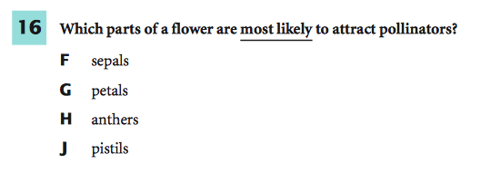
3/9/15
You must explain why your answer is correct.
Please write the page number in your book that supports your explanation.
Use the index of your book to help you.
Notes:
G

Slide 2
Chapter 6 Lesson 1 Part 2
I can show you what the different phases of cell division look like and explain what is happening.
SPI 0707.1.4 Sequence a series of diagrams that depict chromosome movement during plant cell division.

Slide 3
What you will learn:
EXPLAIN why mitosis is important.
EXAMINE the steps of mitosis.

Slide 4
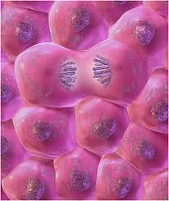
Why this is IMPORTANT
Your growth, like that of many organisms, depends on cell division.

Slide 5
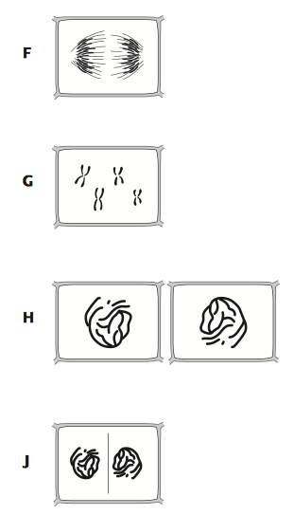
What Mastery Looks Like
Notes:
f

Slide 6
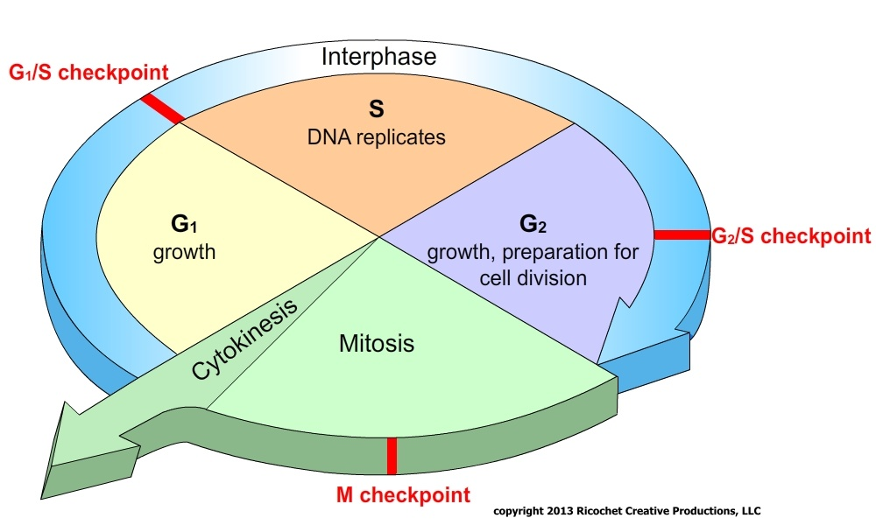
RECAP! Mitosis and Cell Division
Process in which the nucleus divides to form 2 identical nuclei
Mitosis- series of steps
Prophase
Metaphase
Anaphase
Telophase
http://www.brainpop.com/science/cellularlifeandgenetics/mitosis/
Notes:
----- Meeting Notes (2/28/14 08:54) -----
I pick more apples than cherries.

Slide 7
Notes: Make your paper look like mine.
By the way…
I – Interphase
Picked – Prophase (mitosis)
My – Metaphase (mitosis)
Apples – Anaphase (mitosis)
Today – Telophase (mitosis)
STAGES OF MITOSIS
1. Prophase
2. Metaphase
3. Anaphase
4. Telophase

Slide 8
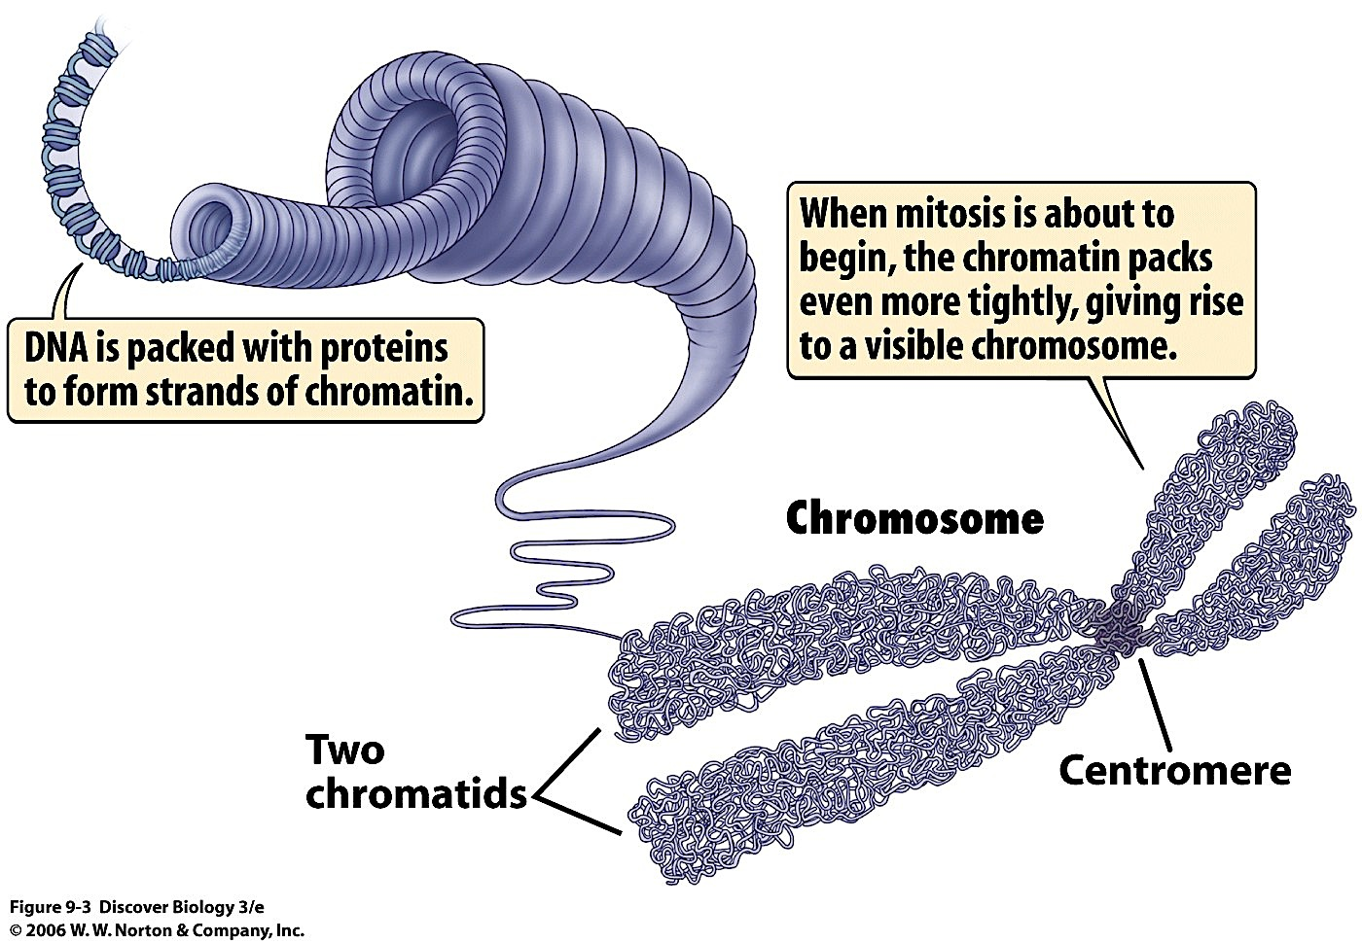
Mitosis and Cell Division You should already have this in your notes.
Chromosome - Structure in nucleus that contains heredity material
During Interphase, each chromosome duplicates
When nucleus is ready to divide, each duplicated chromosome coils tightly into 2 thickened, identical strands = Chromatids

Slide 9
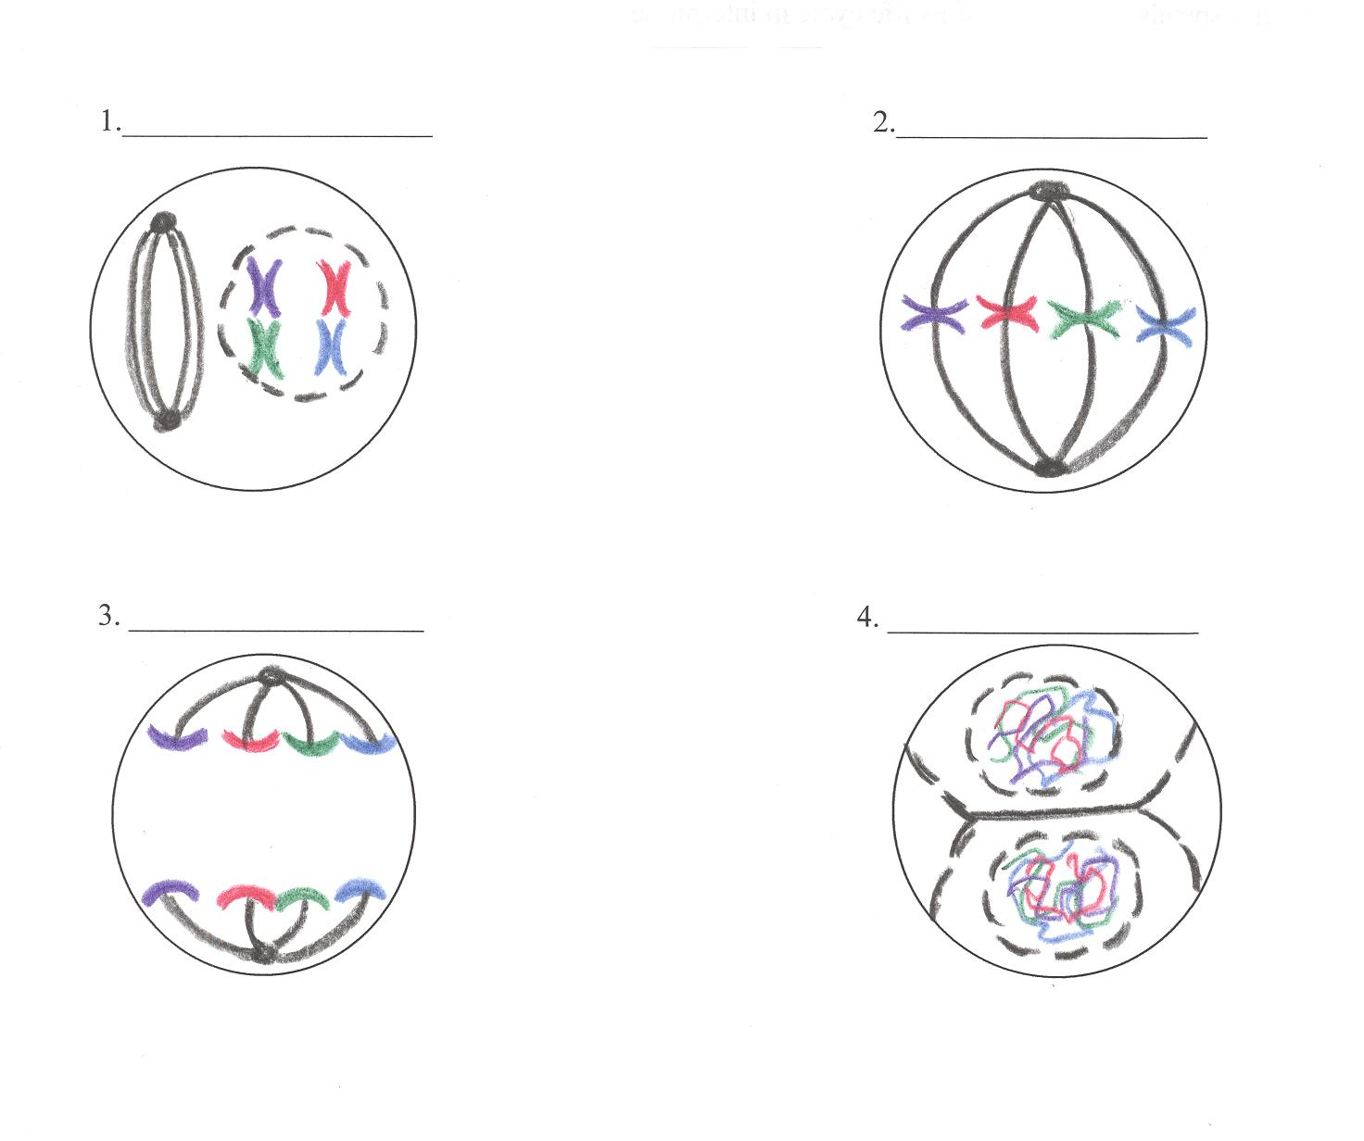
4 phases of nuclear division (mitosis), directed by the cell’s DNA (PMAT)
Prophase
Metaphase (Middle)
Anaphase—(Apart)
Anaphase—(Apart)
Telophase—(Two)

Slide 10
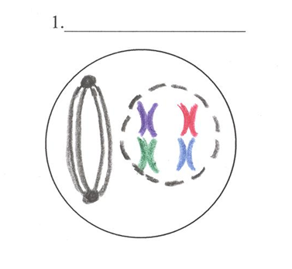
Prophase
Chromosomes coil up
Nuclear envelope disappears
Spindle fibers form

Slide 11
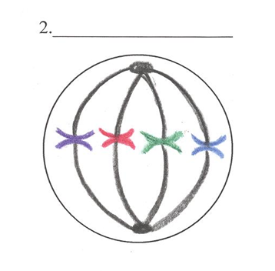
Metaphase—(Middle)
Chromosomes line up in middle of cell
Spindle fibers connect to chromosomes

Slide 12
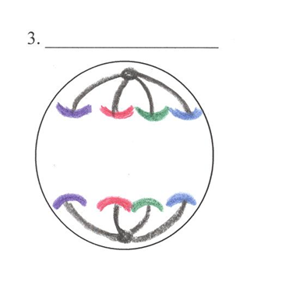
Anaphase—(Apart)
Chromosome copies divide
Spindle fibers pull chromosomes to opposite poles

Slide 13
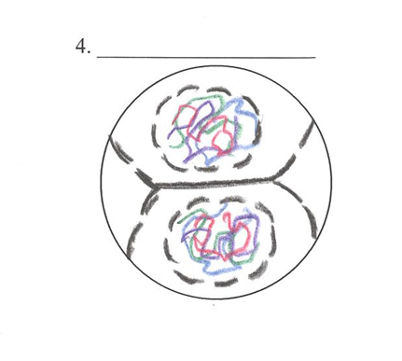
Telophase—(Two)
Chromosomes uncoil
Nuclear envelopes form
2 new nuclei are formed
Spindle fibers disappear

Slide 14
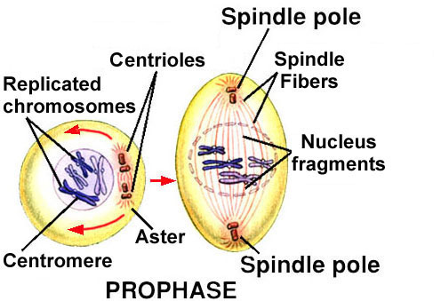
Mitosis and Cell Division
Steps of Mitosis
1st Phase-Prophase
Nucleolus and nucleus membrane disintegrate
Centrioles (2 small structures)- move to opposite ends of cell
Between Centrioles, threadlike spindle fibers begin to stretch across the cell
*Plant cells form spindle fibers, but not centrioles

Slide 15
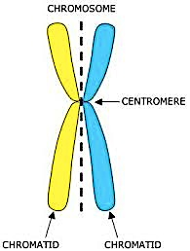
Mitosis and Cell Division
Steps of Mitosis
2nd Phase- Metaphase
Pairs of chromatids line up across center of cell.
Centromere of each pair usually attaches to 2 spindle fibers- one from each side of cell.

Slide 16
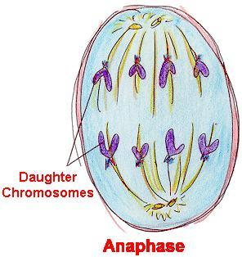
Mitosis and Cell Division
Steps of Mitosis
3rd Phase- Anaphase
1. Each Centromere divides and the spindle fibers shorten
2. Each pair of chromatids separate, and chromatids move to opposite ends of cell
3. Separated chromatids are now chromosomes

Slide 17
Mitosis and Cell Division
Steps of Mitosis
4th Phase- Telophase
1. Spindle fibers start to disappear
2. Chromosomes start to uncoil
3. 2 nuclei form
4. Cytoplasm begins to separate

Slide 18
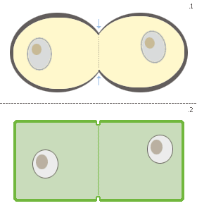
Mitosis and Cell Division
Cytokinesis — the division of the rest of the cell (cytoplasm and organelles) after the nucleus divides
In animal cells the cytoplasm pinches in
In plant cells a cell plate forms
After mitosis and cytokinesis, the cell returns to Interphase to continue to grow and perform regular cell activities (Figure 5 pg. 177)

Slide 19
Mitosis and Cell Division
MITOSIS- https://www.youtube.com/watch?v=C6hn3sA0ip0
MITOSIS Song- https://www.youtube.com/watch?v=I5uFuvkN97I
https://www.youtube.com/watch?v=1cVZBV9tD-A

Slide 20
Exit Ticket
Explain what is happening in each of the phases pictured above.
Then, select an answer and tell how you know.
Notes:
f

Slide 21
RECAP!
Phase | Chromosome Appearance & Location | Important Events
Interphase
Prophase
Metaphase
Anaphase
Telophase
Cytokinesis
DNA replication, cell grows and replicates organelles
DNA copies itself; chromatin
Nuclear envelope disappears, spindle fibers form
Chromosomes coil up
Chromosomes line up in the middle
Spindle fibers connect to chromosomes
Chromosome copies divide and move apart
Spindle fibers pull chromosome copies apart to opposite poles
Nuclear envelopes reform, 2 new nuclei are formed, spindle fibers disappear
Chromosomes uncoil back into chromatin
Division of the rest of the cell: cytoplasm and organelles
Chromatin

