Slide 1
2/12/15
You must explain why your answer is correct.
Please write the page number in your book that supports your explanation.
Use the index of your book to help you.
Notes:
g

Slide 2
Brain Pop
On Friday, I will pass back your quizzes. You can go through the scoot with your partner again and make corrections.
If you were absent, you need to make sure you have all necessary notes and that you are ready to go on Friday.
You will not be allowed to use notes on Friday.

Slide 3
Osmosis The Diffusion of Water
The diffusion of water through a cell membrane is called ___________.
Now! Think back to the picture I showed you earlier!
http://www.youtube.com/watch?v=eQsAzXr0UCU
How are we going to remember this?
If cells weren’t surrounded by water that contains few dissolved substances, water inside of cells would diffuse out of them.
Losing water from a plant cell causes its cell membrane to come away from its cell wall. (Figure 8)
This reduces pressure against its cell wall, and a plant cell becomes limp.
http://highered.mcgraw-hill.com/sites/0072495855/student_view0/chapter2/animation__how_osmosis_works.html
Notes:
Osmosis

Slide 4
Chapter 3 Section 2
SPI 0707.1.5 Explain how materials move through simple diffusion.

Slide 5
What you’ll learn:
Describe the function of a selectively permeable membrane.
Explain how the processes of diffusion and osmosis move molecules in living cells.
Explain how passive transport and active transport differ.

Slide 6
Why it’s important:
Cell membranes control the substances that enter and leave the cells of your body.

Slide 7
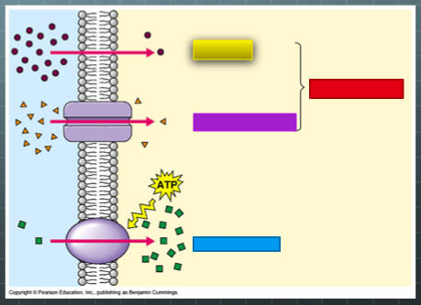
What does mastery look like?

Slide 8
Review
We’ve talked about passive transport.
What is passive transport?
Now, we are going to talk about a type of passive transport called facilitated diffusion.
Since it’s passive transport, is cell going to use energy?

Slide 9
Facilitated Diffusion a type of passive transport
Cells take in many substances.
Some pass easily through the cell membrane by diffusion.
Others (like sugar molecules) are so large that they can enter the cell only with the help of molecules in the cell membrane called transport proteins.
This process, a type of ______ transport, is known as facilitated diffusion.
https://www.youtube.com/watch?v=vKGN_Zhz8AY
Notes:
passive

Slide 10
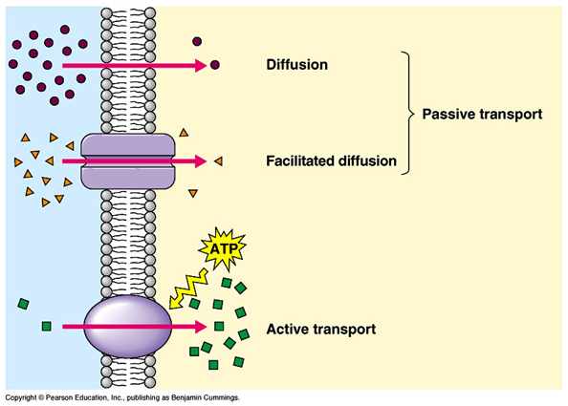
Talk to your group about what this picture shows. What word is behind each block? I’ll come around and listen, then we’ll discuss as a class.
Notes:
Diffusion passive transport
Facilitated diffusion
Active transport

Slide 11
Experiment
To close out our lesson today, we are going to complete the first half of an experiment.
You will be predicting the effects of diffusion on a gummy bear. We will start the experiment today. We will finish it tomorrow morning.
We will go over the sheet in here.
Your prediction will serve as your exit slip today.
REMEMBER: Our objective is, “Explain how materials move through simple diffusion.”
Grab a pencil and SILENTLY line up for the science lab.

Slide 12
Exit Ticket
Experiment

Slide 13
STOP!
Red – I am so confused. (Write down a question for me to answer that will help you better understand.)
Yellow – I am on the way to understanding, but I need more time. (Write down one thing you understand about this topic. Write down one question for me to answer.)
Green – I’ve got this! (Answer these questions. What will happen ? )

