Slide 1
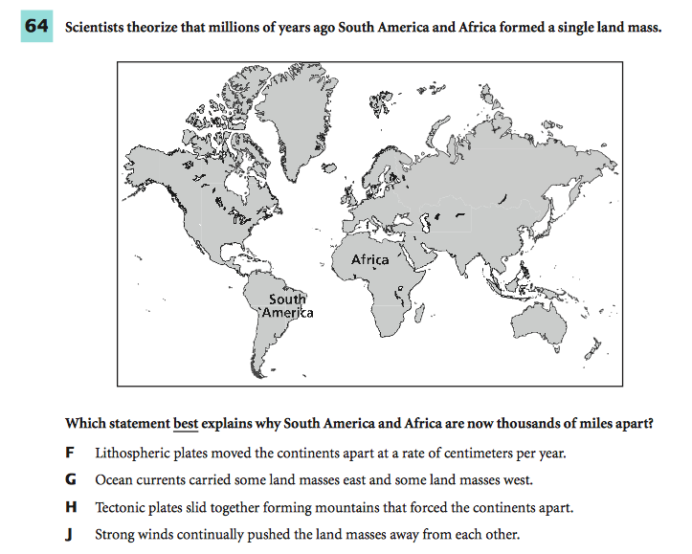
2/10/15
Notes:
f

Slide 2
Chapter 3 Section 2
SPI 0707.1.5 Explain how materials move through simple diffusion.

Slide 3
What you’ll learn:
Describe the function of a selectively permeable membrane.
Explain how the processes of diffusion and osmosis move molecules in living cells.
Explain how passive transport and active transport differ.

Slide 4
Why it’s important:
Cell membranes control the substances that enter and leave the cells of your body.

Slide 5
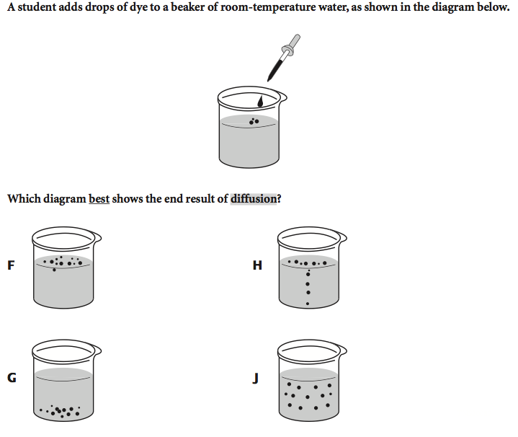
If you can answer this question, you’re on your way to mastering the objective.

Slide 6
If you can answer this question, you’re on your way to mastering the objective.

Slide 7
Vocabulary
Passive transport
Diffusion
Equilibrium
Osmosis
Active transport
Endocytosis
Exocytosis

Slide 8
Brain Pop
http://www.brainpop.com/science/cellularlifeandgenetics/passivetransport/

Slide 9
Group
With your group, come up with a definition for the word “passive” based on the video.
When you work in groups, if you ever just sit there and do nothing, you’re being passive.
Notes:
Dictionary.com not participating readily or actively; inactive: a passive member of a committee.
3.
not involving visible reaction or active participation: to play a passive role.

Slide 10
Passive Transport *Key points from BP
Passive Transport – a cell doesn’t have to use ________to let something in or out
Selectively Permeable – lets some things come in while keeping others _____ (Cell Membranes are selectively permeable.)
Diffusion – Passive transport works through diffusion
Notes:
Energy
out

Slide 11
Open your book!
Chapter 3 Section 2

Slide 12
Passive Transport *Key points from book
Cells take in ______, ______, and other substances from their environments.
Cells also release _________ materials into their environments.
A cell’s membrane is selectively _______________.
Notes:
Food, oxygen
waste
permeable

Slide 13
Group
With your group, think of something you have seen in real life that could be considered selectively permeable. Be ready to give me one group answer in one minute.
Notes:
Window screen?
Collander?

Slide 14
Passive Transport *Key points from book
The way things move through a cell membrane depends on the size of the molecules or particles.
If movement through membrane happens without energy, it is called passive transport.
Notes:
What does this word passive mean?

Slide 15
Diffusion *Key points from book
Molecules in __________, __________, and ___________ move constantly and randomly.
The random movement of molecules from an area where there is relatively more of them into an area where there is relatively fewer of them is called _____________.
Molecules of a substance will continue to move from one area into another until the relative number of these molecules is equal in the two areas.
This is known as _____________. At this point, diffusion stops.
Notes:
Solids, liquids, and gases
Diffusion
equilibrium

Slide 16
Exit Ticket
Draw a picture that illustrates the following concept.
Molecules of a substance will continue to move from one area into another until the relative number of these molecules is equal in the two areas.
Put your homework in the tray. If you don’t have it, sign the conduct book.

Slide 17
What you’ll learn:
Describe the function of a selectively permeable membrane.
Explain how the processes of diffusion and osmosis move molecules in living cells.
Explain how passive transport and active transport differ.

Slide 18
Why it’s important:
Cell membranes control the substances that enter and leave the cells of your body.

Slide 19
What does mastery look like?

Slide 20
Diffusion

Slide 21
White Board
Questions to ponder: http://www.biologylessons.sdsu.edu/ta/classes/lab4/TG.html
Answer these with your group.

Slide 22
Osmosis The Diffusion of Water
The diffusion of water through a cell membrane is called ___________.
Now! Think back to the picture I showed you earlier!
http://www.youtube.com/watch?v=eQsAzXr0UCU
How are we going to remember this?
If cells weren’t surrounded by water that contains few dissolved substances, water inside of cells would diffuse out of them.
Losing water from a plant cell causes its cell membrane to come away from its cell wall. (Figure 8)
This reduces pressure against its cell wall, and a plant cell becomes limp.
http://highered.mcgraw-hill.com/sites/0072495855/student_view0/chapter2/animation__how_osmosis_works.html
Notes:
Osmosis

Slide 23
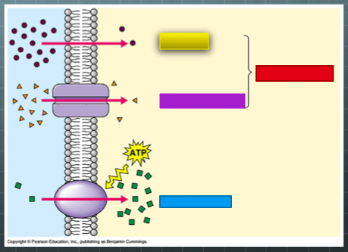
What does mastery look like?

Slide 24
Review
We’ve talked about passive transport.
What is passive transport?
Now, we are going to talk about a type of passive transport called facilitated diffusion.
Since it’s passive transport, is cell going to use energy?

Slide 25
Facilitated Diffusion a type of passive transport
Cells take in many substances.
Some pass easily through the cell membrane by diffusion.
Others (like sugar molecules) are so large that they can enter the cell only with the help of molecules in the cell membrane called transport proteins.
This process, a type of ______ transport, is known as facilitated diffusion.
https://www.youtube.com/watch?v=vKGN_Zhz8AY
Notes:
passive

Slide 26
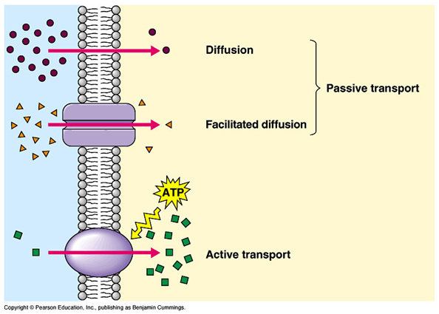
Talk to your group about what this picture shows. What word is behind each block? I’ll come around and listen, then we’ll discuss as a class.
Notes:
Diffusion passive transport
Facilitated diffusion
Active transport

Slide 27
Experiment
To close out our lesson today, we are going to complete the first half of an experiment.
You will be predicting the effects of diffusion on a gummy bear. We will start the experiment today. We will finish it tomorrow morning.
We will go over the sheet in here.
Your prediction will serve as your exit slip today.
REMEMBER: Our objective is, “Explain how materials move through simple diffusion.”
Grab a pencil and SILENTLY line up for the science lab.

Slide 28
STOP!
Red – I am so confused. (Write down a question for me to answer that will help you better understand.)
Yellow – I am on the way to understanding, but I need more time. (Write down one thing you understand about this topic. Write down one question for me to answer.)
Green – I’ve got this! (Answer these questions. What will happen ? )

Slide 29
Active Transport
Sometimes a substance is needed inside a cell even though the amount of that substance inside the cell is already greater than the amount outside the cell.
When an input of energy is required to move materials through a cell membrane, __________ __________ takes place.
http://www.brainpop.com/science/cellularlifeandgenetics/activetransport/
Notes:
Active transport

Slide 30
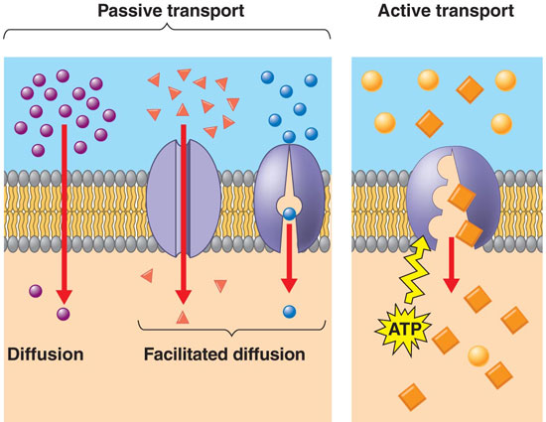

Slide 31
Endocytosis and Exocytosis
Some molecules and particles are too large to move by diffusion or to use the cell membrane’s transport proteins.
Large protein molecules and bacteria, for example, can enter a cell when they are surrounded by the cell membrane.
The cell membrane folds in on itself, enclosing the item in a sphere called a vesicle. Vesicles are transport and storage structures in a cell’s cytoplasm.

Slide 32
Endocytosis and Exocytosis
The process of taking substances into a cell by surrounding it with the cell membranes is called endocytosis. Some one-celled organisms take in food this way.
The contents of a vesicle can be released by a cell using the process called exocytosis. Exocytosis occurs in the opposite way that endocytosis does.
A vesicle’s membrane fuses with a cell’s membrane, and the vesicle’s contents are released.

Slide 33
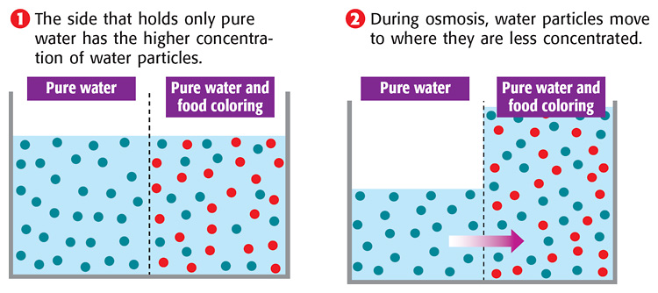
Concept Review

Slide 34
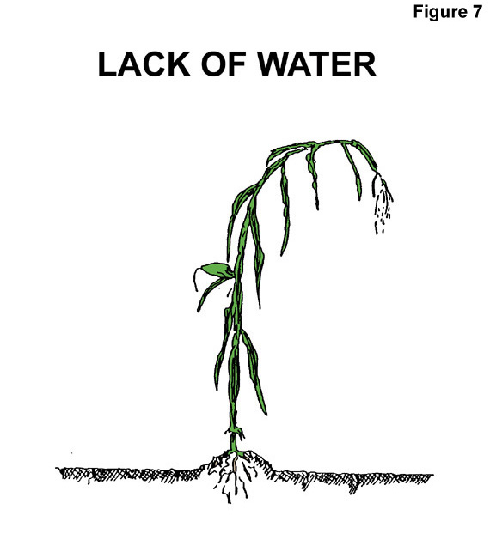
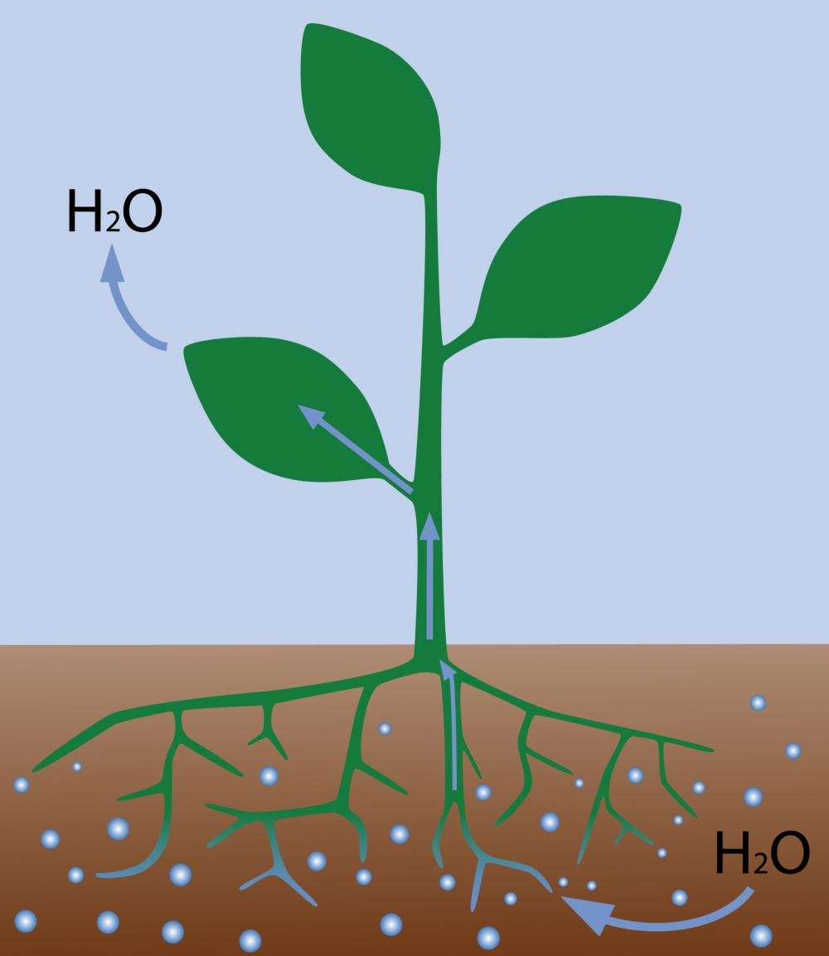
Concept Review
Osmosis makes plants firm.

Slide 35
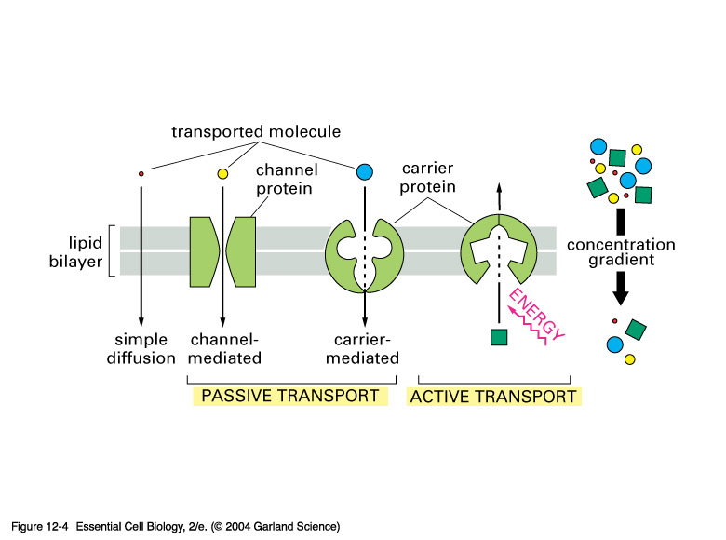
Concept Review
Active Transport = requires cell to use energy
Active transport usually involves the movement of particles from an area of low concentration to an area of high concentration.

Slide 36
Concept Review
Endocytosis
The active-transport process by which large particles, such as large protein, are taken into the cell.

Slide 37
Concept Review
Exocytosis
The active-transport process by which large particles, such as wastes, leave the cell.

