Slide 1
Bell Work
Complete 1-6 of the Section 1 Review on p. 458.

Slide 2
Chapter 15 section 3 Properties of waves
GLE: Investigate the types and fundamental properties of waves
SPI 0707.11.5 Compare and contrast the different parts of a wave.

Slide 3
What You’ll Learn
The difference between amplitude and wavelength

Slide 4
FLAPS
How do we measure and describe waves?
How does knowing these properties help engineers?

Slide 5
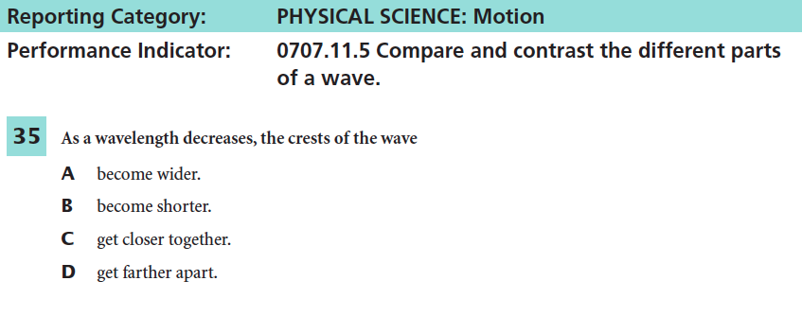
What Mastery Looks Like
Notes:
c

Slide 6
I. Amplitude
Can we measure how high a wave's crest reaches or how low the trough dips down?
https://www.youtube.com/watch?v=_L3cNFKKWM0 3.14 min
Turn to neighbor: Tell him or her, what you learned from the video about amplitude.
Amplitude and Energy
Waves transfers energy from one place to another. (The amount of energy is related to amplitude)
Large amplitudes = more energy
How can waves be used in energy conservations?
http://science360.gov/obj/video/a98bc37b-31c6-4817-97d6-a31ab5cfeebe/producing-energy-ocean-waves

Slide 7
Tsunamis
Tsunamis are large amplitudes that have devastating effects.
They are caused by underwater earthquakes along faults on the seafloor.
Is waves moves toward shallow water and slows down, the amplitude grows.
What are some ways that we can protect ourselves from Tsunamis?
http://science360.gov/obj/video/26970abc-47e0-4618-aa14-b4ef87987006/tsunami-research

Slide 8
II. Wavelength
Another way to describe a wave is by its wavelength.
-In transverse waves – wavelength is measured from
crest to crest and/or trough to trough
-In compressional waves – measure from center of
rarefaction to rarefaction or
compression to compression
How are to the wavelengths similar and different?
Notes:
The crest of a transverse wave is similar to the compression of a longitudinal wave. Trough/rarefaction

Slide 9
Partner A: Explain what wavelength is Partner B: Explain what amplitude is
What do you know? In you own words

Slide 10
II. Wave length cont.
In Electromagnetic waves – wavelengths range from kg – radio waves to less that a diameter of an atom in X-rays and gamma rays.
Range is called electromagnetic spectrum.
Using the table on p. 460. Answer the following questions.
1. In each of the following pairs, which form of radiation has the LONGER WAVELENGTH:
a. red light or blue light
b. microwaves or radio waves
c. infrared radiation or red light
d. gamma rays or UV radiation
Notes:
Red
Radio waves
Infrared
UV radiation

Slide 11
Exit Ticket
Explain your answer using information discussed in class.

