Slide 1
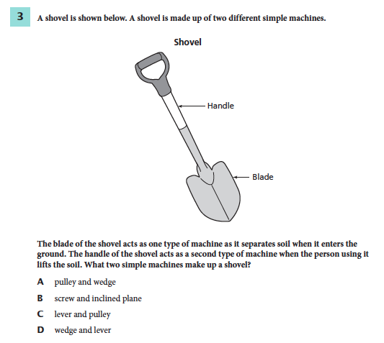
REVIEW BELLWORK
1. Use textbook to support your answer and an explanation.
ADVANCEMENT:
List 3 Examples of transverse waves you have seen in the past few weeks and 3 examples of compressional waves you have seen.

Slide 2
Chapter 15 Day 3 Section 1
SPI 0707.11.6 Differentiate between transverse and longitudinal waves in terms of how they are produced and transmitted.

Slide 3
What You Will Learn
What sound waves are
How they are transmitted
What an electromagnetic wave is

Slide 4
What Mastery Looks Like
You will be able to compare and contrast mechanical and electromagnetic waves.
You will be able to give examples of electromagnetic waves.
You will be able to explain how sound waves are produced.

Slide 5
Sound Waves
Yesterday, we discussed how sound waves are _________ waves.
Like all waves, sound waves are made by something that is __________.
Everyone hum your favorite song. As you SOFTLY hum, put your fingers on your throat. What do you feel?
compressional
vibrating

Slide 6
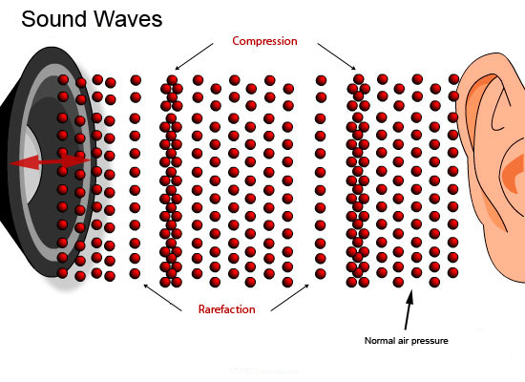
Making Sound Waves
Something that _____ in the air produces a sound wave.
In a speaker, the electric current causes the speaker cone to vibrate back and forth. As the speaker cone moves outward, air molecules next to it are pushed closer together.
vibrates
Read the last paragraph and look at the picture on p. 457.
With your shoulder partner, discuss how compressions and rarefactions are different.
Notes:
Particles are squeezed together in compressions and are farther apart in rarefactions.

Slide 7
Sound Waves
http://www.brainpop.com/science/energy/sound/
Use your white boards to take the quiz after the video is over.
Notes:
A
B
C
D
A
D
C
B
A
D

Slide 8
Electromagnetic Waves
If no matter is needed for a wave to travel, it’s an electromagnetic wave.
If electromagnetic waves don’t need matter, can they still travel through matter if necessary?
Yes, these waves can travel in matter or in space.
Radio waves from TV and radio stations travel through air, but can be reflected from a satellite in space (where there is no matter).
Examples of electromagnetic waves: radio waves, infrared waves, visible light waves, ultraviolet waves, x rays, and gamma rays.

Slide 9
Electromagnetic Spectrum
VIDEO
Notes:
Video is optional. It’s very deep.

Slide 10
Radiant Energy from the Sun
The Sun emits electromagnetic waves that travel through space and reach Earth.
Electromagnetic waves carry energy called radiant energy.
Most of the radiant energy that reaches Earth is carried by infrared and visible light waves.
Infrared waves = make you feel warm
Visible Light waves = help you see

Slide 11
Exit Ticket
Complete 1-6 of the Section 1 Review on p. 458.

