Slide 1
Websites
Google:
PBS Learning Media Waves
PBS Learning Media Frequency

Slide 2
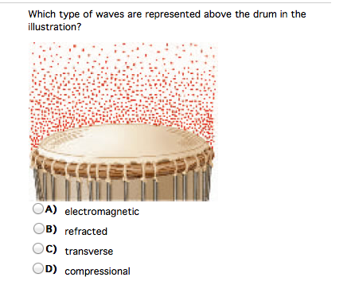
Bell Work
Write a complete sentence and
EXPLAIN! Use your notes and book

Slide 3
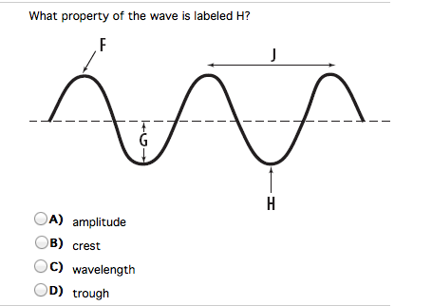

Slide 4
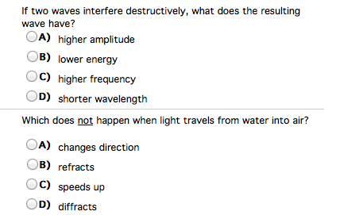

Slide 5
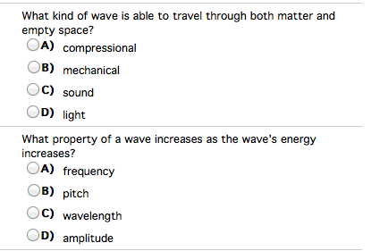

Slide 6
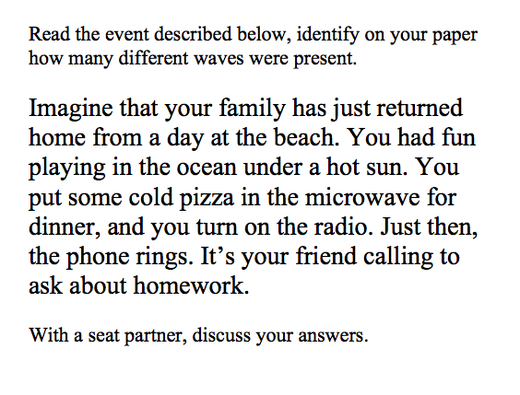

Slide 7
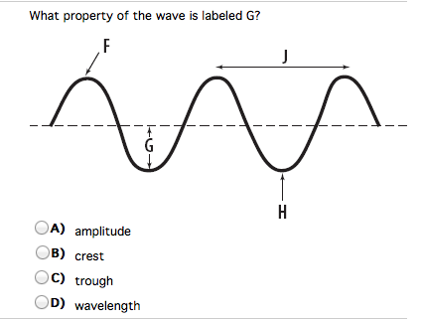

Slide 8
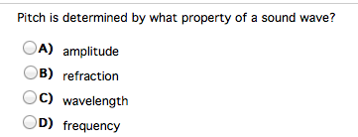
1. Use textbook to support your answer and an explanation. Chose all that apply.
ADVANCEMENT:
List 3 Examples of transverse waves you have seen in the past few weeks and 3 examples of compressional waves you have seen.

Slide 9
Chapter 15 Day 2 Section 1
SPI 0707.11.5 Compare and contrast the different parts of a wave.
SPI 0707.11.6 Differentiate between transverse and longitudinal waves in terms of how they are produced and transmitted.

Slide 10
What You Will Learn
The different parts of the wave
More about the differences between transverse and compressional waves
Examples of transverse and compressional waves

Slide 11
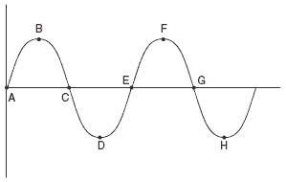
What Mastery Looks Like Copy in Notes Bell Work
You should be able to explain what B, D, F, and H are called.
You should be able to explain the role they play in transverse waves.
You should be able to explain whether or not a longitudinal wave has a crest.
Notes:
A longitudinal wave does not have crest; so how can its wavelength be determined?

Slide 12
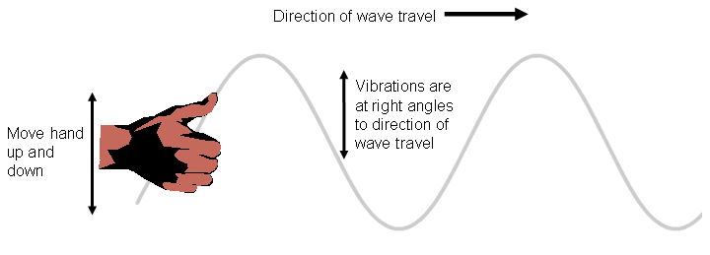
Transverse Waves
Silently, read Transverse Waves on p. 456.
In your notes, draw a diagram that shows the vibration of the matter in relation to the wave motion as described in the text.

Slide 13
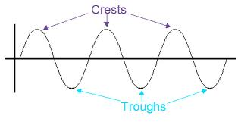
Transverse Wave
What do you call the highest point of a transverse wave?
What do you call the lowest point of a transverse wave?

Slide 14
Waves rap
Crests at the top
Then the trough drop
Transverse waves
Energy don’t stop

Slide 15
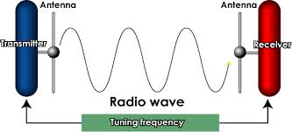
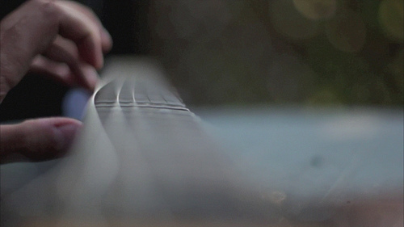
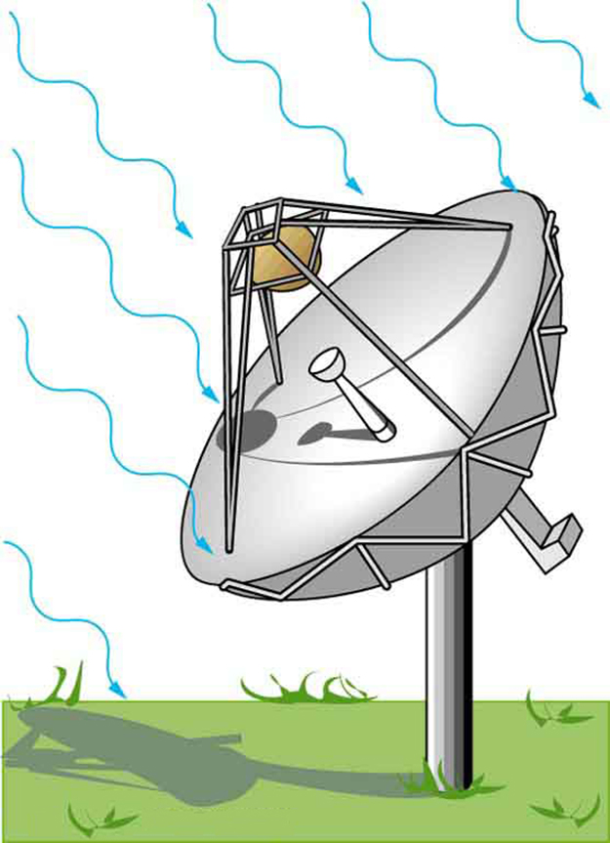
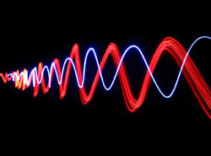
Transverse Waves Examples
Light Waves
Radio Waves
Television Waves
Water Waves
Vibrating Guitar Strings

Slide 16
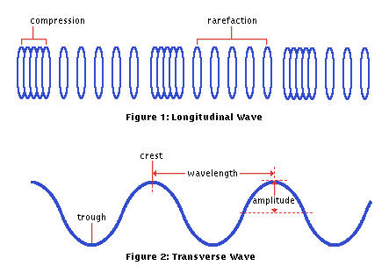
Transverse Waves vs. Compressional Waves
https://www.youtube.com/watch?v=w2s2fZr8sqQ

Slide 17
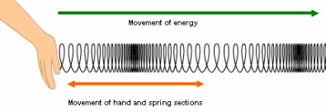
Compressional (Longitudinal) Waves
Read p. 457 Compressional Waves.
Draw a diagram that shows the direction of the matter in the medium in relation to the wave motion as described in the text.
What is the medium that the compressional wave travels through in this reading selection?

Slide 18
Compressional (Longitudinal) Waves
https://www.youtube.com/watch?v=j1Q5TFMqsFo

Slide 19
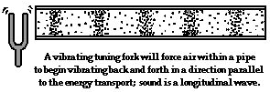
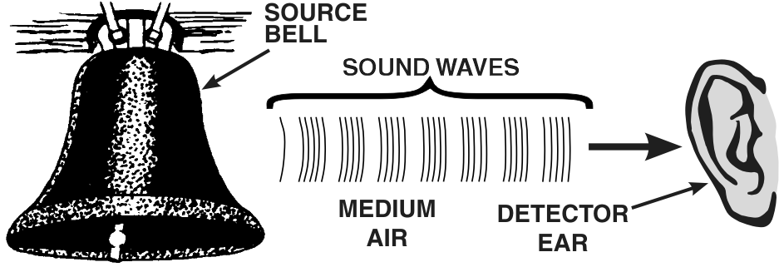
Compressional Wave Examples
Sound Waves https://www.youtube.com/watch?v=zKwpv8mZHRM
Ultrasound Waves https://www.youtube.com/watch?v=oRlowjn63Lc

Slide 20
Exit Ticket
1. Explain what B, D, F, and H are called.
2. Explain the role they play in transverse waves.
3. Explain whether or not a longitudinal (compressional) wave has a crest.
Complete section 1 of the note-taking sheet when you finish.
Notes:
A longitudinal wave does not have crest; so how can its wavelength be determined?

