Slide 1
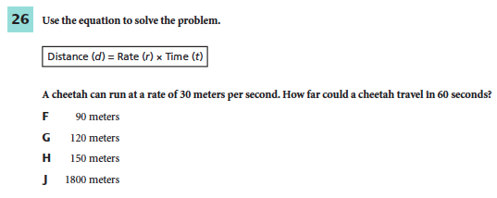
September 16, 2014
You must explain why your answer is correct.
Please write the page number in your book that supports your explanation.
Use the index of your book to help you.
Notes:
J

Slide 2
Chapter 14 Day 6
Objective:
Differentiate
between
the
six
simple
machines.

Slide 3
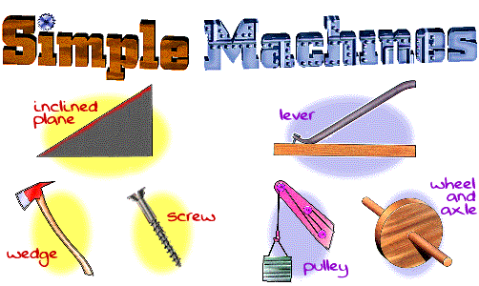
Simple Machines

Slide 4
What You Will Learn
How to distinguish between a pulley and a wheel and axle
Where you might see a pulley and wheel and axle in everyday life
How to calculate mechanical advantage of pulleys and wheel and axles.

Slide 5
What Mastery Looks Like
3. A system of pulleys allows a mechanic to lift an 1800 N engine.
If the mechanic exerts a force of 600 N on the pulley system, what is the mechanical
advantage of the machine?

Slide 6
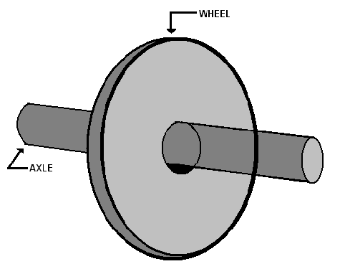
Wheel and Axle
A wheel and axle is two circular objects of DIFFERENT diameters attached so that rotate together.
http://www.brainpop.com/technology/simplemachines/wheelandaxle/

Slide 7
Wheel and Axle
With your group, discuss different wheel and axles you see in your life every day.

Slide 8
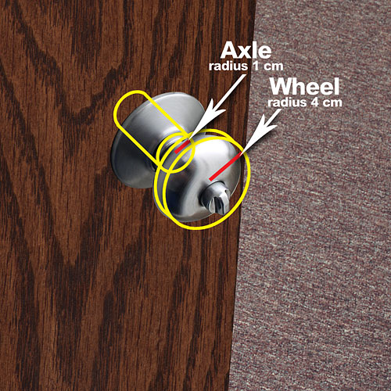
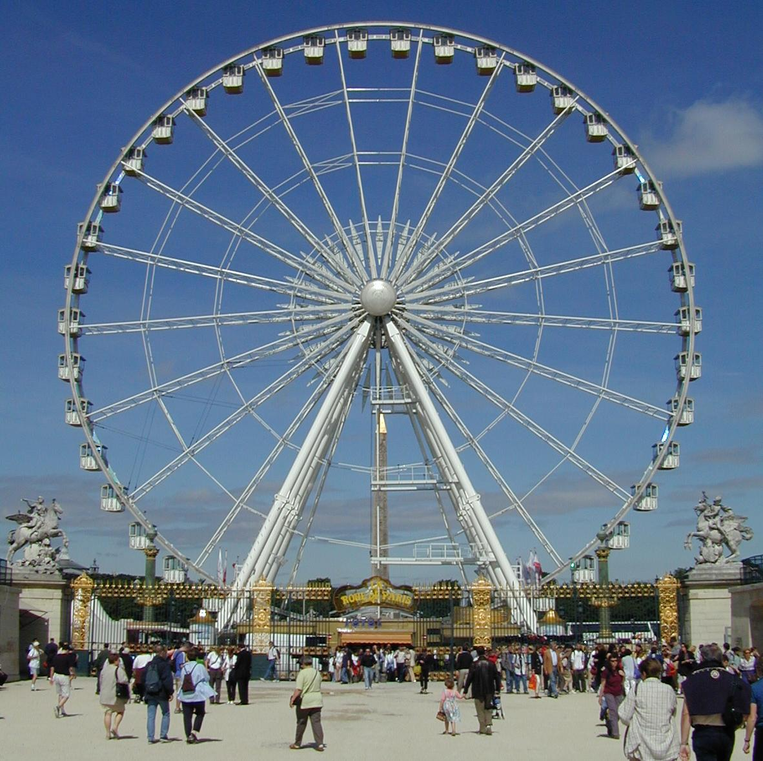
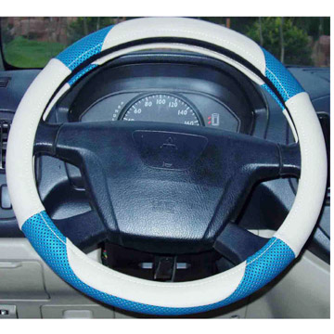
Examples of Wheels and Axles

Slide 9
Wheels and Axles
In some devices, the input force is used to turn the wheel, and the output force is exerted by the axle. Because the wheel is larger than the axle, the mechanical advantage is greater than one. So the output force is greater than the input force. Examples: door knobs, steering wheel, and screw driver.
In other devices, the input force is applied to turn the axle, and the output force is exerted by the wheel. Then, the mechanical advantage is less than one and the output force is less than the input force. A fan and a Ferris wheel are examples of this type of wheel and axle.

Slide 10
Mechanical Advantage of a Wheel and Axle
https://www.youtube.com/watch?v=ndT35aqDfAQ

Slide 11
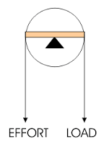
Pulley
A pulley consists of a grooved wheel with a rope or cable wrapped over it.
http://www.brainpop.com/technology/simplemachines/pulley/

Slide 12
Pulleys
When have you used a pulley?

Slide 13
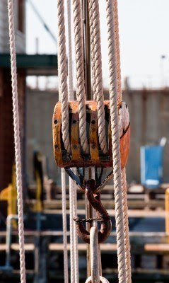
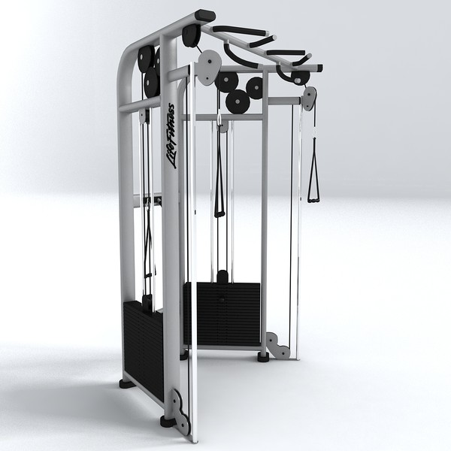
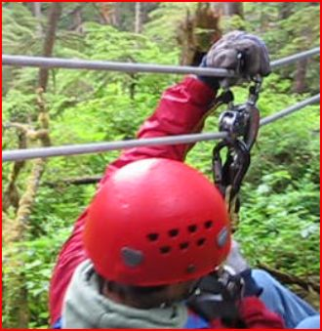
Pulley Examples

Slide 14
Fixed vs Movable Pulleys
Fixed Pulley
Mechanical Advantage = 1
Some pulleys, like one on a sail or flagpole, are attached to a structure.
When you pull down, you pull something up.
This is a fixed pulley.
It DOES NOT change the fore you need to exert or the distance.
Instead, it changes the direction.
Movable Pulley
Mechanical Advantage = 2
You can attach a pulley to the object you are lifting.
This allows you to exert a smaller force to lift the object.
Sometimes, you will see a mixture of fix and moveable pulleys. This is a pulley system. The mechanical advantage of a pulley system is equal to the number of sections of rope pulling up on the object.

Slide 15
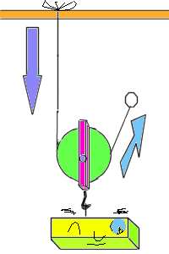
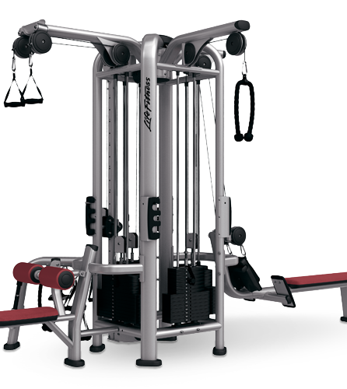
Fixed vs Moveable
https://www.youtube.com/watch?v=LiBcur1aqcg

Slide 16
Exit Ticket
Which do you think YOU use more in everyday life?
Pulley
Wheel and Axle
Explain your answer.

