Slide 1
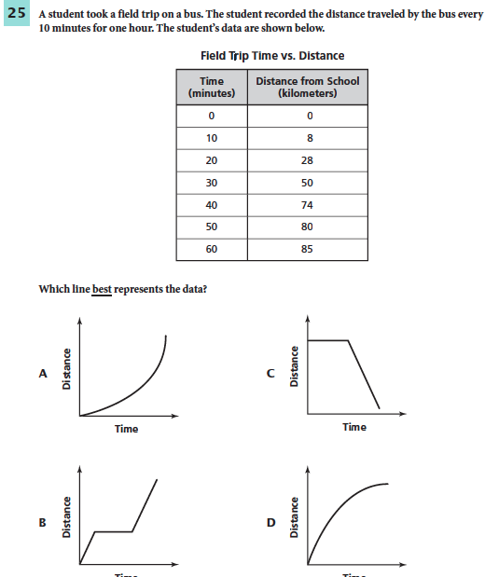
September 15, 2014
You must explain why your answer is correct.
Please write the page number in your book that supports your explanation.
Use the index of your book to help you.
Notes:
D

Slide 2
Check Homework

Slide 3
Chapter 14 Day 5 Lesson 2 Screw, Wedge, Lever
SPI 0707.11.1 Differentiate between the six simple machines.

Slide 4
What You Will Learn
How to distinguish between wedges, screws, and levers
Where you see wedges, screws, and levers in everyday life

Slide 5
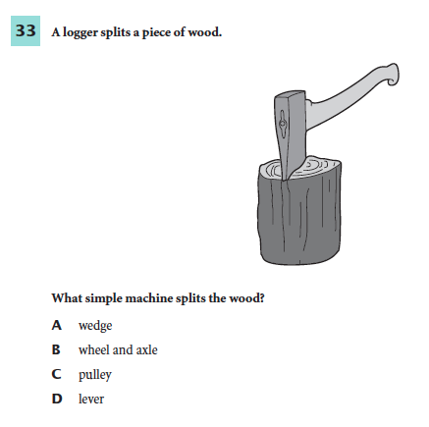
What Mastery Looks Like

Slide 6
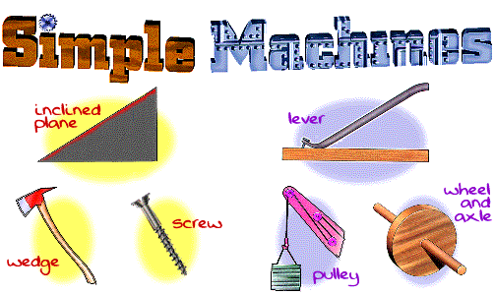
Simple Machines

Slide 7
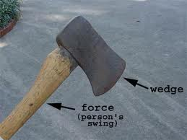
What is a wedge?
A wedge is an inclined plane that moves.
It can have one or two sloping sides.
A wedge’s mechanical advantage increases as it becomes longer and thinner.
https://www.youtube.com/watch?v=LAAwZird80k

Slide 8
Wedge Examples
Can you think of wedges that you see in real life? With your group, make a list.

Slide 9
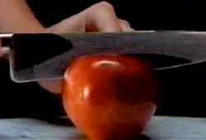
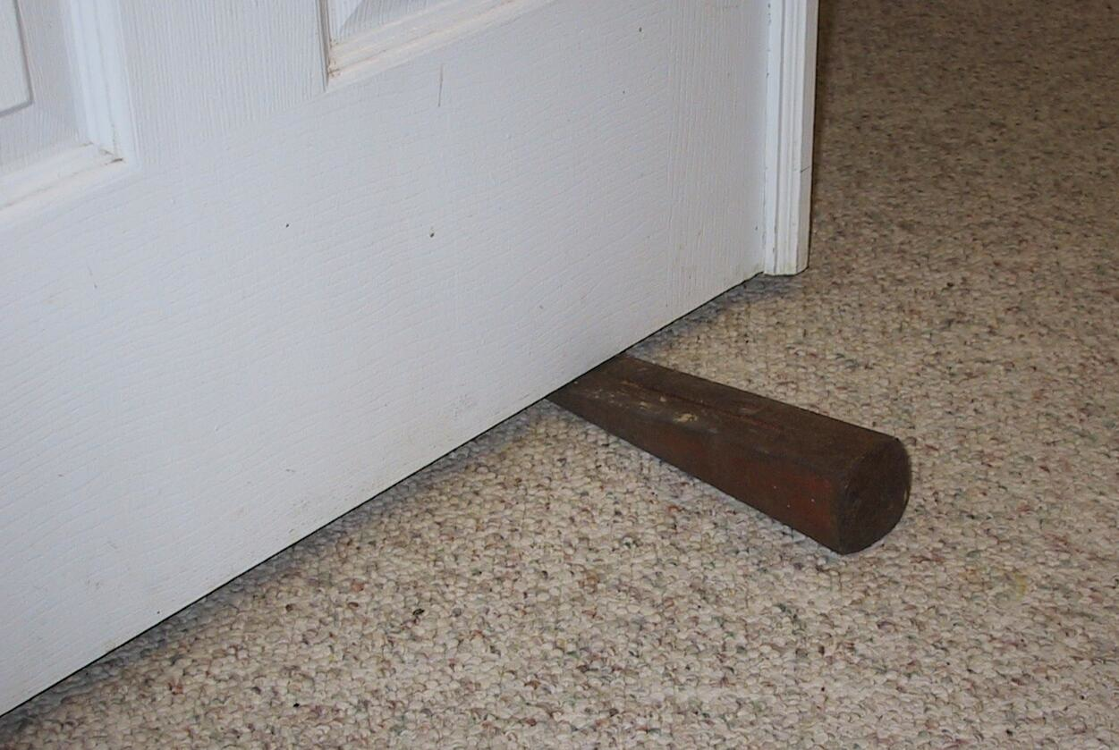
Wedge Examples
As you push your front teeth into the apple, the downward effort force is changed by your teeth into a sideways force that pushes the skin of the apple apart.
A knife is a wedge with a sharpened edge that can cut objects into pieces
A doorstop is used to hold doors in place. The doorstop is a wedge that goes between the door and the floor.

Slide 10
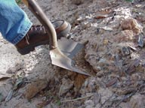
Is this a wedge?
Yes! As the nail is pounded into a piece of wood, the bottom part of the nail opens up a large enough hole for the shaft of the nail to move through.
Yes! The sharp edge of the shovel is a wedge.

Slide 11
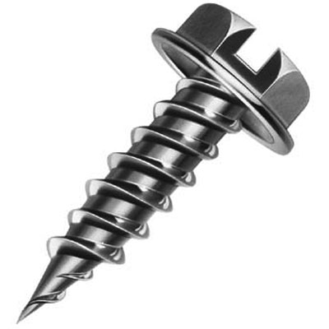
What is a screw?
Look at this picture. With your group, describe what you see.
The screw is another form of an inclined plane.
A screw is an inclined plane wrapped around a cylinder or post.
The inclined plane on a screw forms the screw threads.
https://www.youtube.com/watch?annotation_id=annotation_239178&feature=iv&src_vid=LAAwZird80k&v=4oPPQpF7bHY

Slide 12
When have you used a screw?
Discuss with your group.

Slide 13
Screw Examples

Slide 14
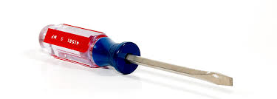
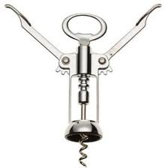
Is this a screw?
No, this is actually an example of a wheel and axle.
Yes, this is a corkscrew. It helps remove
corked bottles.

Slide 15
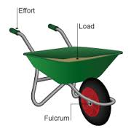
What is a lever?
A lever is any rigid rod or plank that pivots, or rotates about a point. The point about which the lever pivots is called a fulcrum.
https://www.youtube.com/watch?v=E8RA9Kw_IaE

Slide 16
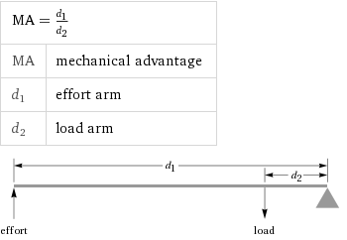
What is a lever?
The mechanical advantage of a lever depends on the location of the input force, the output force, and the fulcrum.
The mechanical advantage can be calculated by dividing the distance from the fulcrum to the input force by the distance from the fulcrum to the output force.

Slide 17
When have you used a lever?
Discuss with your group.

Slide 18
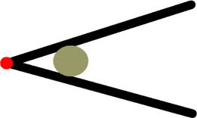
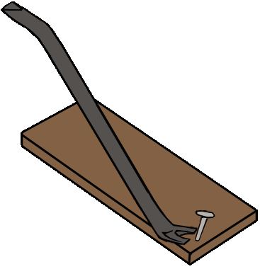
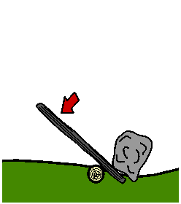
Lever Examples
http://www.brainpop.com/technology/simplemachines/levers/

Slide 19
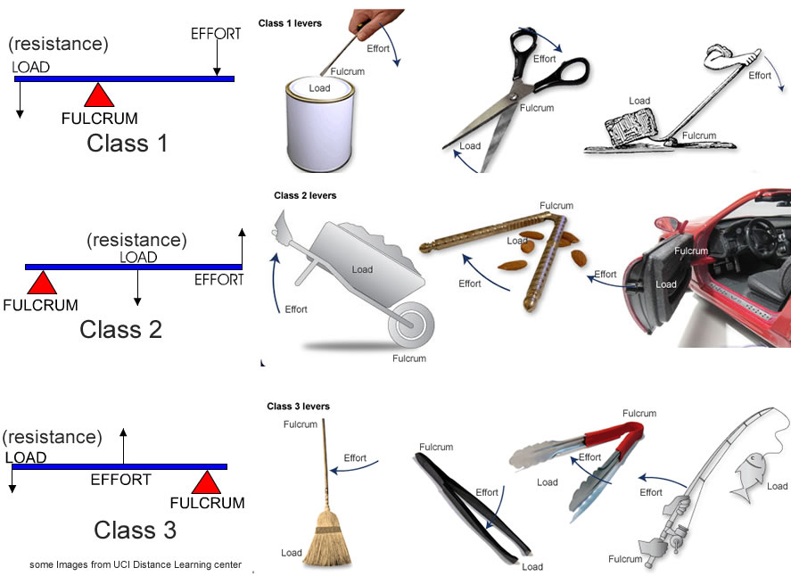
Three Types of Levers

Slide 20
Exit Ticket
Pick two of the three simple machines we learned about today.
Draw a picture of each.
Describe a time you have used those simple machines.

