Slide 1
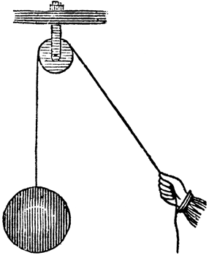
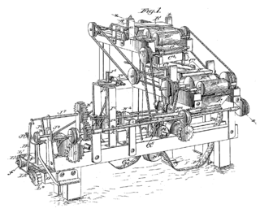
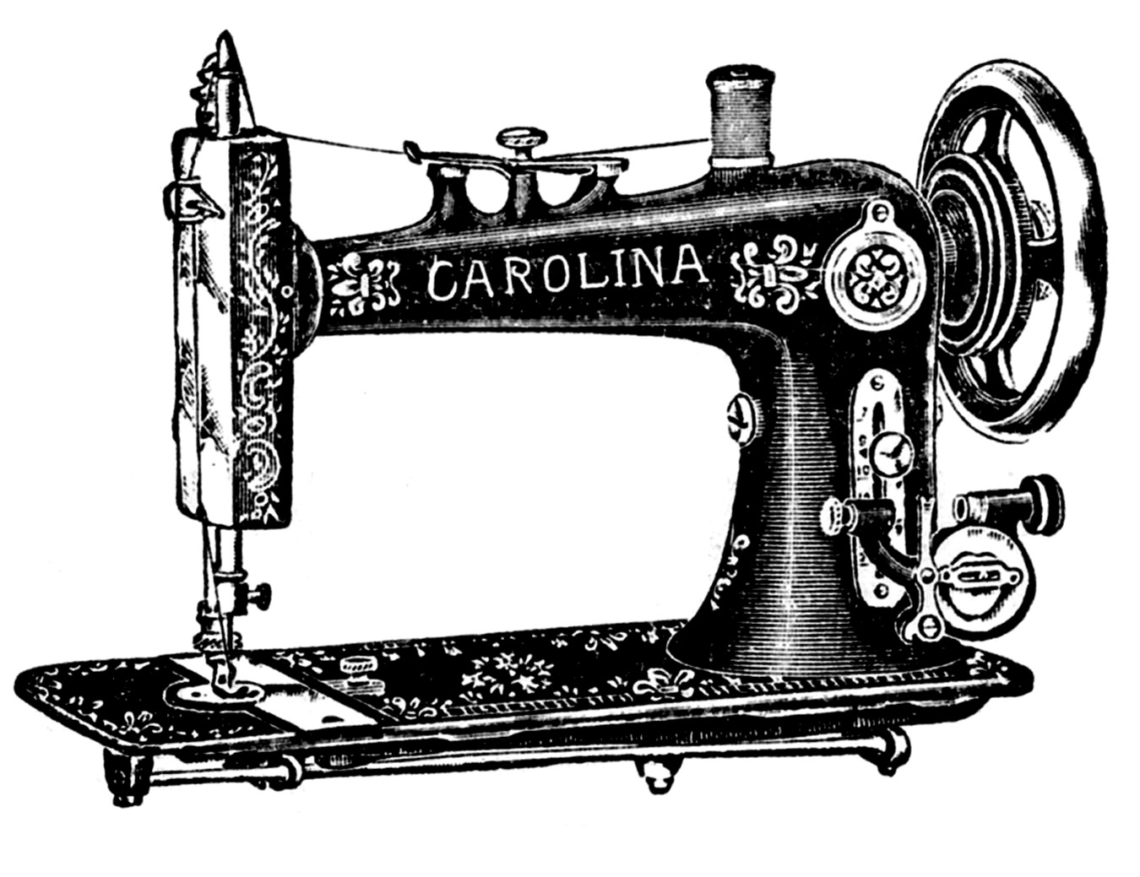
Using Machines Chapter 14 Lesson 2 432, 433, and 435
Determine the amount of force needed to do work using different simple machines.

Slide 2
What You Will Learn
Explain how a machine makes work easier
Calculate mechanical advantage
Explain how friction reduces efficiency

Slide 3
What Mastery Looks Like This is the type of question you will be able to answer at the end of this lesson.
What is the mechanical advantage of a lever that requires an input force of 20 N and lifts an object that weighs 60 N?
Notes:
MA = 3

Slide 4
What is a machine?
With your group, discuss what you think a machine is.
A machine is a device that makes doing a task easier.
With your group, discuss how you think a machine makes things easier.
A machine makes work easier by changing the size and/or direction of a force.

Slide 5
Mechanical Advantage
Machines make work easier, but they DON’T DECREASE the amount of work you need to do.
A machine changes the way you do work.
https://www.youtube.com/watch?v=-huZw8Dq3JU&safe=active

Slide 6
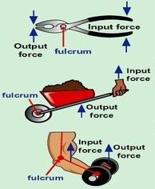
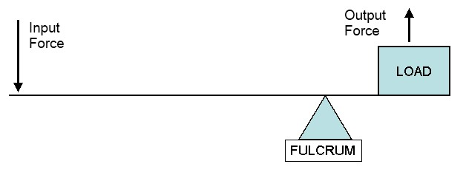
Mechanical Advantage
The force you apply on a machine is the input force.
The force that the machine applies is the output force.

Slide 7
Mechanical Advantage
A machine can increase force or distance, but not both.
A machine makes work easier by…
changing the amount of force you need to exert
the distance over which the force is exerted
the direction in which you exert your force.

Slide 8
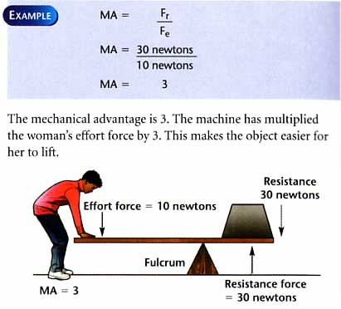
Changing Force
Mechanical advantage tells how many times a machine multiplies force.
https://www.youtube.com/watch?v=yhzMYHiuEC4

Slide 9
Mechanical Advantage Equation
Practice Problem #1 p. 433

Slide 10
Efficiency
The efficiency of a machine is the ratio of the output work to the input work.
Basically, it’s a comparison of a machine’s work output with work input.
Efficiency (in percent) = work output/work input x 100
Machines aren’t 100% efficient because some of the work done is used to overcome friction.
Practice Problem #1 p. 435

Slide 11
Exit Ticket
To lift a crate, a pulley system exerts a force of 2,750 N. Find the mechanical advantage of the pulley system if the input force is 250 N.
Notes:
11

