Slide 1
You must explain why your answer is correct.
Please write the page number in your book that supports your explanation.
Use the index of your book to help you.
Notes:
A

Slide 2
Chapter 14 Lesson 1 Day 2
I can explain how force relate to the movement of objects.

Slide 3
Learning Objective
I can calculate power.
I can explain the relationship between work and power.

Slide 4
What Mastery Looks Like These are the types of questions you will be able to answer at the end of this lesson.

Slide 5
Agenda
Check homework.
Watch Brain Pop.
Take notes.
Complete Applying Math on page 429.

Slide 6
What is Power?
How quickly or rate at which work is done.
Amount of work done per unit time.
If two people mow two lawns of equal size and one does the job in half the time, who did more work?
Same work. Different power exerted.
POWER = WORK / TIME
Notes:
Username and password is palmbeach

Slide 7
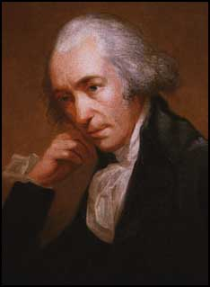
The Watt
A unit named after Scottish inventor James Watt.
Invented the steam engine.
P = W/t
Joules/second
1 watt = 1 J/s

Slide 8
Calculating Power
As a class, let’s look at p. 429.
If you do 200 J of work in 12 s, How much power did you use?
Complete page 429 1-2 with a partner.
Notes:
See teacher’s edition to go over correct answer.
Please walk around room and check answers.

Slide 9
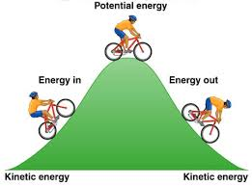
B. Work and Energy
When something is moving, it has energy of motion – kinetic energy
http://www.brainpop.com/science/energy/kineticenergy/
Energy of an object changes or increases when you do work and lift it higher – potential energy.
Notes:
Username and password is palmbeach

Slide 10
C. Power and Energy
Work on an object increases its energy.
Energy can never be created or destroyed.
It can gain or lose the energy
Amount of work done = amount of energy transferred.
Power = the amount of energy transferred even when no work is done.
Ex heat transfers from warm to cold object.
Power is always the rate at which energy transferred.

Slide 11
Exit Ticket
*How much power is used when 600 J of work are done in 10 seconds?
Show work, I will come around and check.
*HOMEWORK:
Notes:
60 watts

