Slide 1
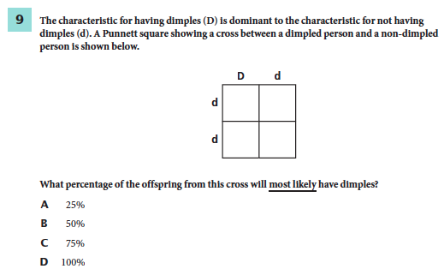
August 21, 2014
You must explain why your answer is correct.
Please write the page number in your book that supports your explanation.
Use the index of your book to help you.
Notes:
B

Slide 2
Chapter 13 (Lesson 3)Day 9

Slide 3
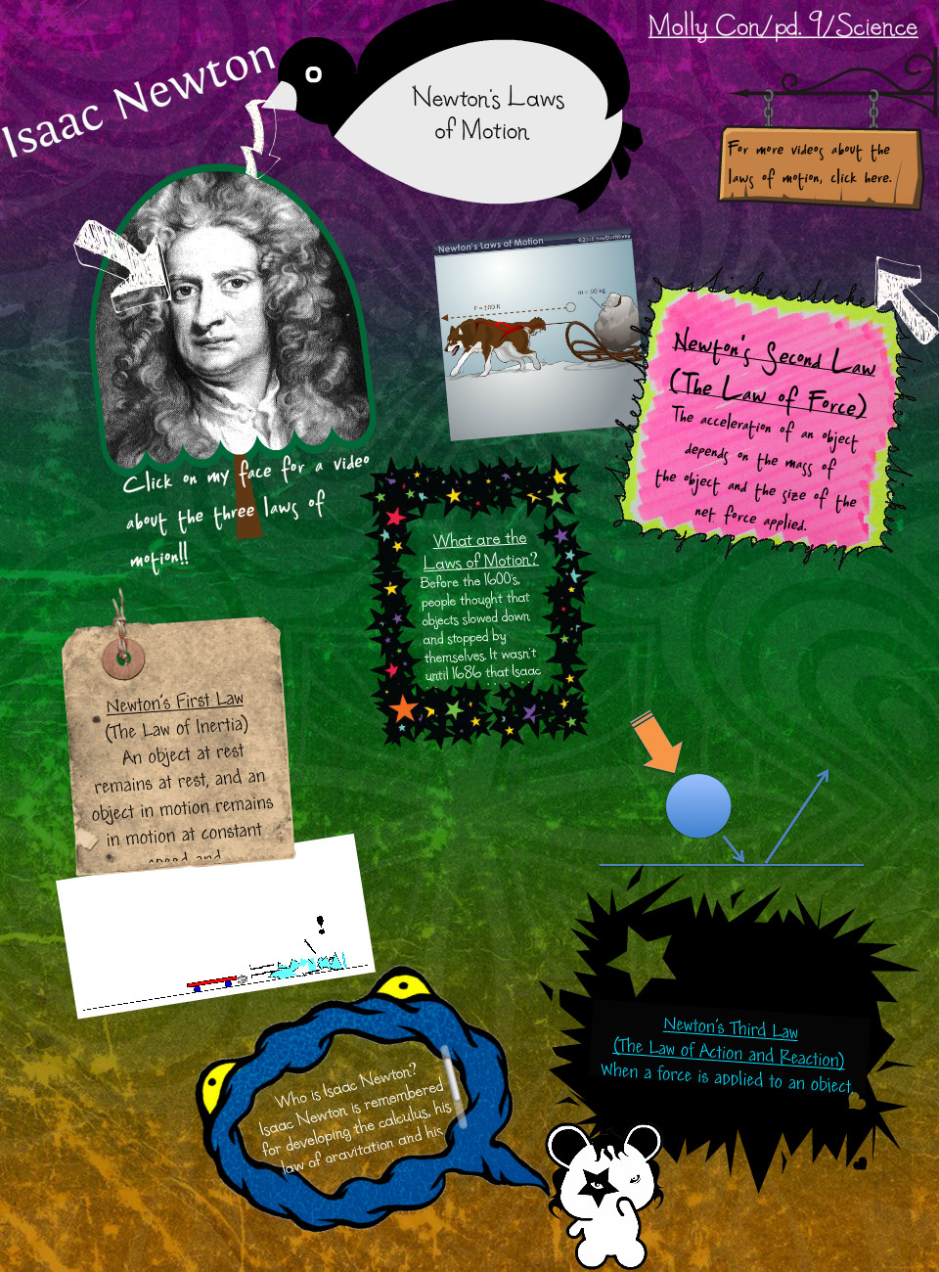
CHAPTER 13 LESSON 3
I can identify how Newton’s laws of motion relate to the movement of objects.
GLE: 0707.11.4 Investigate now Newton’s laws of motion explain an object’s movement

Slide 4
What You Will Learn
How balanced forces affect motion
What Newton’s first law says
How it looks in real life

Slide 5
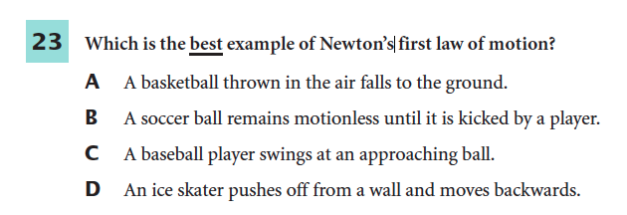
What Mastery Looks Like
Notes:
B

Slide 6
Why it’s Important
Newton’s three laws explain how forces cause motion to change.

Slide 7
I. Newton’s Laws
of Motion
Changes in motion are caused by the forces that act on them.
ex. Galaxies in the universe, planets in the solar system, and cars on a busy street
Laws were first presented by Sir Isaac Newton – 1687.
These rules apply to all objects

Slide 8
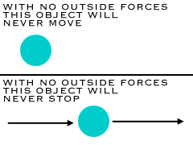
II. The First Law of Motion
How does an object move if the forces acting on it are balanced?
If the forces acting on an object are balanced, then an object at rest remains at rest and an object in motion keeps moving in a straight line with constant speed.
When the forces on an object are balanced, the motion of the object doesn’t change
https://www.youtube.com/watch?v=Q0Wz5P0JdeU

Slide 9
II. First Law of Motion cont.
Why does the net force acting on the basketball in Figure 14 cause it to move in a curved path? see 410
According to the first law, the net force acting on the object must not be zero for an object to change speed or direction.
https://www.youtube.com/watch?v=t8WEcA_VqHQ
Changing Direction
1. A moving obj. changes direction when the net force
acting on the obj. is not in the same direction as the
object’s motion.
2. Then, the direction of motion curves toward the direction of the unbalanced force.
see 410 Figure 14

Slide 10
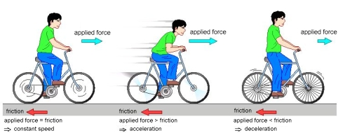
II. First Law of Motion cont.
B. Changing Speed
If the net force is in the same directions in which the object is moving
It speeds up and continue to move in a straight line.
If the net force acts in the direction opposite to an object’s motion
the object slows down and moves in a straight line.

Slide 11
Exit Ticket
If I want to keep an object moving, do I need to keep applying a force?
A. Objects eventually stop because a force – such as friction or gravity- acts against the object’s motion. Once an object is in motion, the energy that was used to initiate the motion is irrelevant. In the absence of forces acting against that motion, a moving object would, in fact, continue to move forever! This is true of a bouncing ball, a speeding care, a galloping horse and a shooting star.

