Slide 1
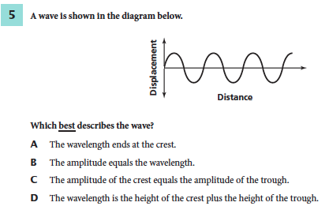
August 15, 2014
You must explain why your answer is correct.
Please write the page number in your book that supports your explanation.
Use the index of your book to help you.
Notes:
C

Slide 2
Chapter 13 Day 5 (Lesson 2)
Distinguish between speed and velocity.
Identify and explain how Newton’s laws of motion relate to the movement of objects.

Slide 3
FORCE Review
Brain Pop
Notes:
http://www.brainpop.com/science/motionsforcesandtime/force/

Slide 4
What You Will Learn
The difference between balanced and unbalanced forces
Examples of contact and non-contact forces
The effects of friction
The difference between static and sliding friction
What buoyancy is
What air resistance causes

Slide 5
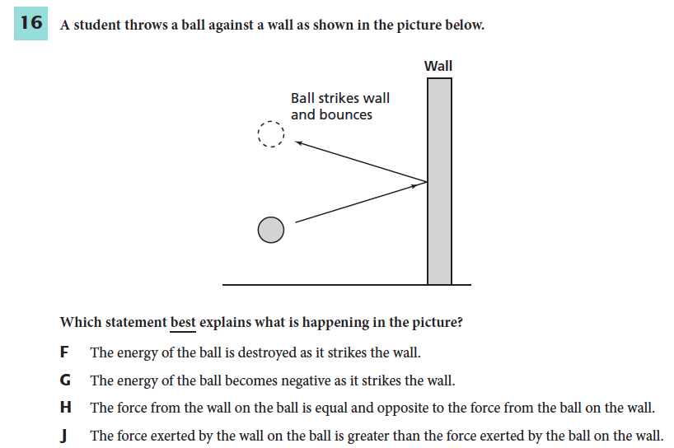
What Mastery Might Look Like
Notes:
H is the answer to both.

Slide 6
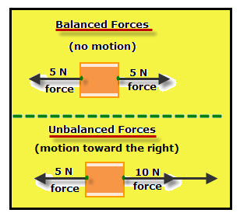
Balanced vs. Unbalanced
Balanced Forces – The forces acting on an object are balanced forces if the net force is zero. Balanced forces do not change the motion of an object.
Unbalanced Forces – If the net force of forces is NOT zero.

Slide 7
Contact vs. Non-Contact Forces
Contact Force – a force that is exerted only when two objects are touching.

Slide 8
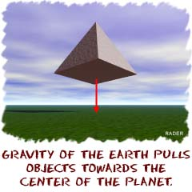
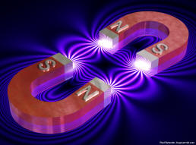
Contact vs. Non-Contact Force
Non-contact Force – forces that can be exerted by one object on another even when the objects aren’t touching.
What are some examples of non-contact forces you might see?
Notes:
Apple falling down from the tree is the best and most popular example of non contact force viz. gravity.
Iron pins being attracted when in the vicinity of a magnet without any physical contact.
Repulsion force, when two magnets are close to each other is also an example of non contact force.
The charging of the hair and attraction of paper bits towards it.
Falling of rain drops on earth is also an example of non contact force .
Free fall of feather towards earth is by the virtue of gravity.
There are many real life examples from electrostatics showing the attraction of small materials towards objects.

Slide 9
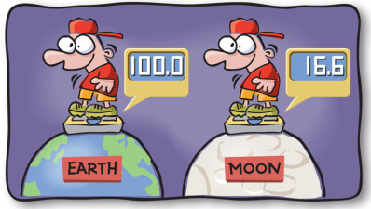
Weight
The gravitational force Earth exerts on an object is the weight of an object.
Because weight is a force, it is measured in Newtons.
Notes:
1 Originally, the kg was defined
The Weight of an object is the force of gravity currently being exerted on that object. Weight is different from mass because, while the mass of an object is always the same regardless of the object’s location, the weight will be different depending on where it is, and more specifically, how much gravity there is at that location.
So, when you measure weight using pounds, it should be pounds-force that is being measured. However, one of the reasons people use pound-mass and pound-force is that they will be very close to the same number any place on earth, where gravity is always close to 32.174 ft/s2.

Slide 10
Friction
https://www.youtube.com/watch?v=AX_lCOjLCTo
Why does this happen?
FRICTION!
Friction is a contact force that resists the sliding motion of two surfaces that are touching.

Slide 11
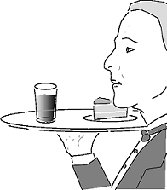
Static Friction
Static means “not moving.”
Static friction is the force between two surfaces in contact that keeps them from sliding when a force is applied.
When you stand on a ramp, you don’t slide down because of the static friction between the ramp and your shoes.

Slide 12
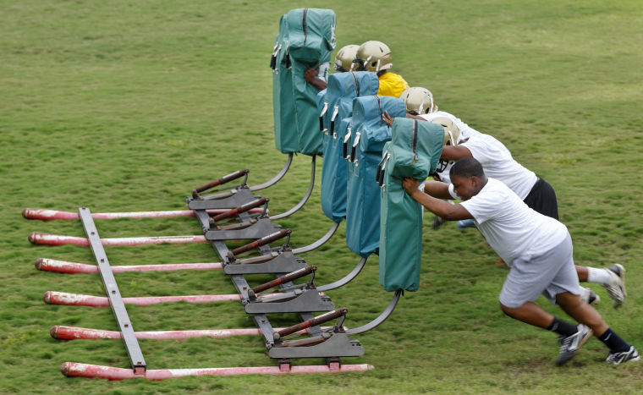
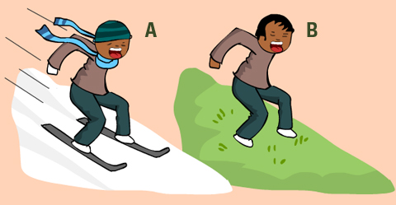
Sliding Friction
Sliding friction is the force that opposes the motion of two sliding surfaces in contact.
If you push hard enough on the cardboard box filled with books, it will start sliding.
If you stop pushing after the box starts sliding, it will slow down and stop.

Slide 13
Friction
What causes friction?
https://www.youtube.com/watch?v=lOAIvTwPsZQ
0:00 – 5:30
All surfaces are covered with microscopic dips and bumps. Friction is causes by sticking of the two surfaces at these bumps and dips.

Slide 14
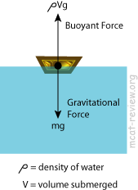
The Buoyant Force
The buoyant force is a force exerted by a fluid on an object that is in the fluid. The buoyant force is always upward.

Slide 15
The Buoyant Force

Slide 16
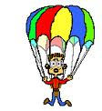
Air Resistance
A sheet of crumbled paper falls faster than an identical flat, horizontal sheet of paper. This is thanks to air resistance.
Air resistance is a contact force that opposes the motion of objects moving in air.

Slide 17
What Mastery Might Look Like
Notes:
H is the answer to both.

