Slide 1
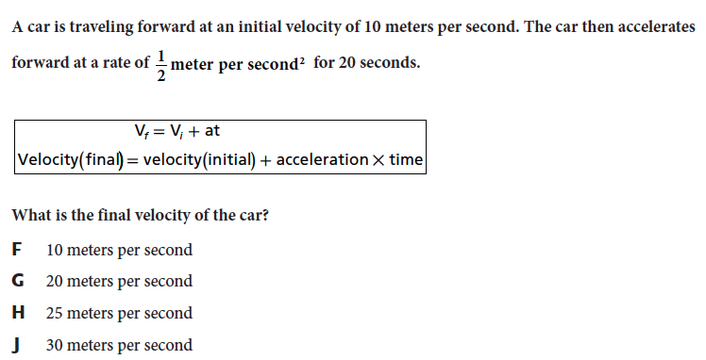
Review
Notes:
The answer is G.

Slide 2
Something to think about…
http://www.sciencechannel.com/tv-shows/head-rush/videos/head-rush-terminal-velocity.htm
Notes:
http://www.ducksters.com/questions/physicsvelocityanswers.php

Slide 3
Chapter 13 Day 4
(Lesson 2)
Distinguish between speed and velocity.
Identify and explain how Newton’s laws of motion relate to the movement of objects.

Slide 4
What You Will Learn
What a force is
What happens when forces combine

Slide 5
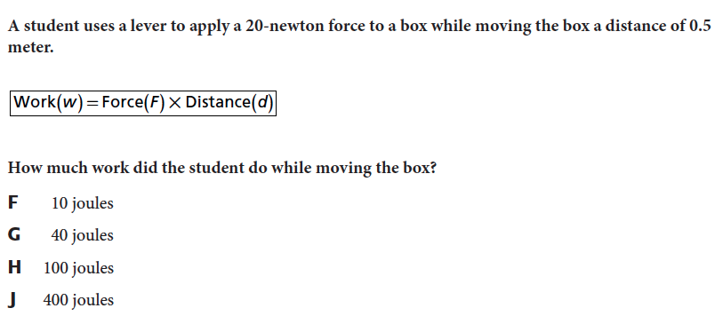
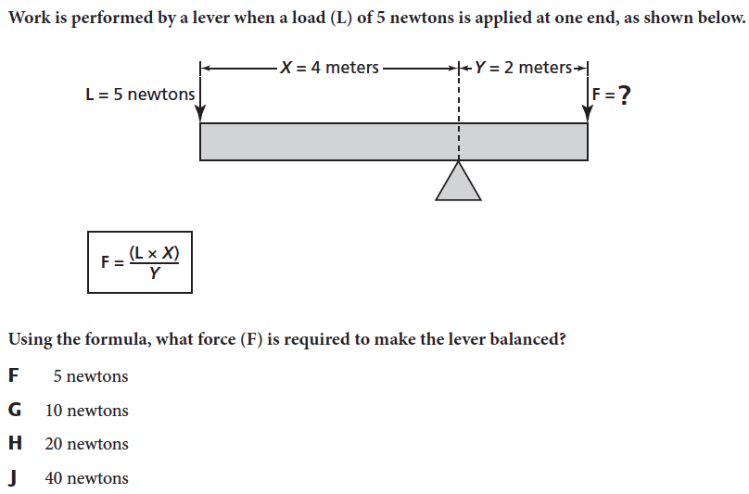
What Mastery Looks Like

Slide 6
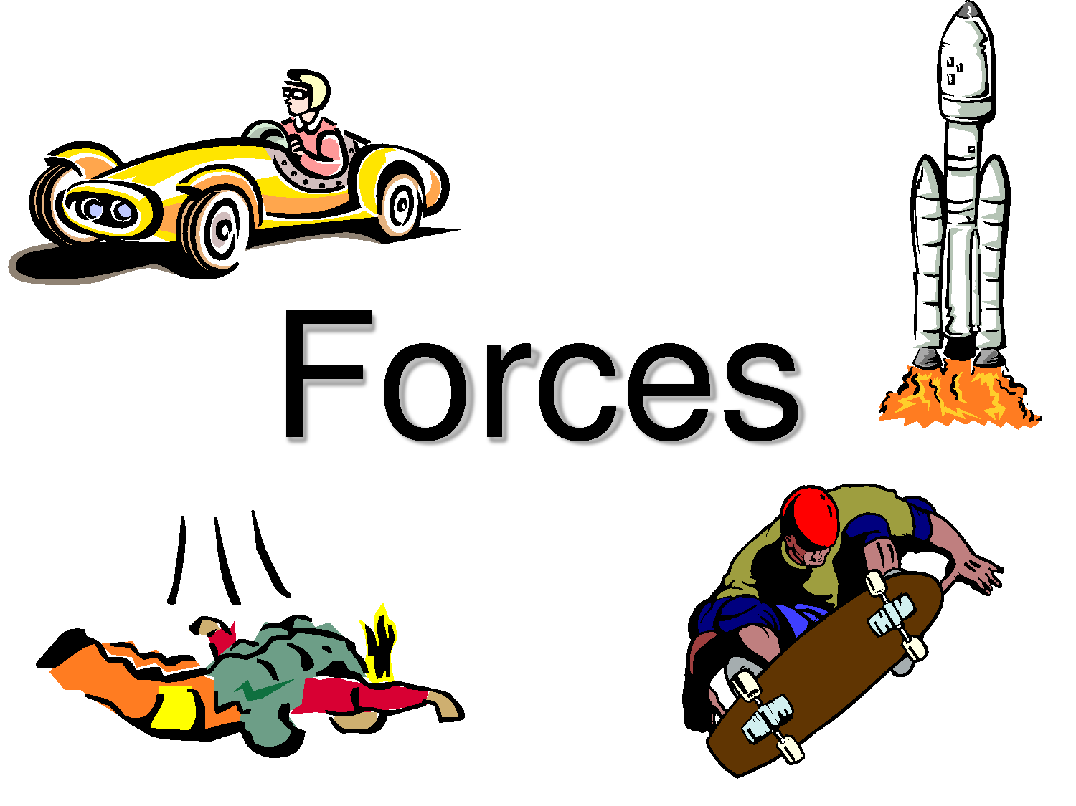
Force
What is a force? A push or pull that one object exerts on another object
Notes:
http://www.brainpop.com/science/motionsforcesandtime/force/

Slide 7
Force
Force has two things.
Direction
size

Slide 8
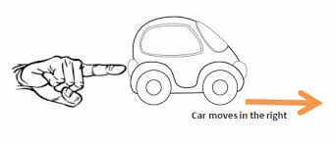
Force
The direction of the force is the direction of the push or pull.
Pushing or pulling harder increases the size of the force exerted

Slide 9
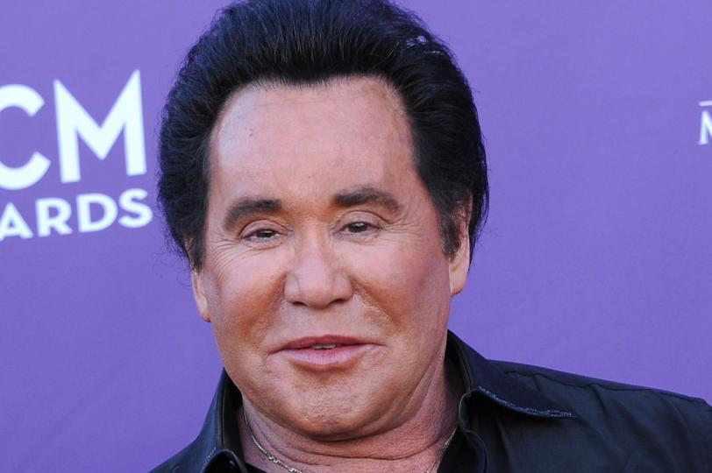
Force
The size of force is measured in Newtons. (N)

Slide 10
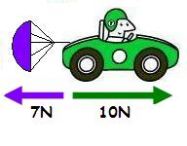
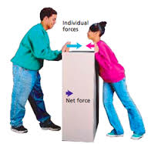
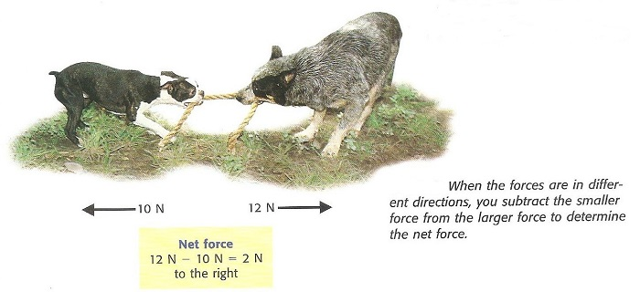
When Forces Combine
Net Force: The combination of all the forces acting on an object is the net force.

Slide 11
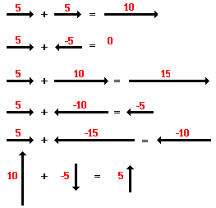
Net Force

Slide 12
Can you solve?

