Slide 1
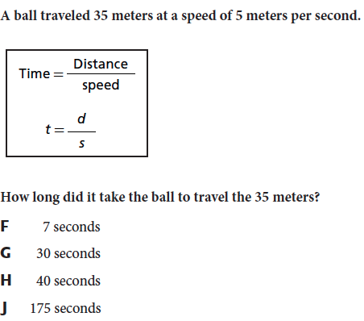
Review! Complete on your white board.
Notes:
The answer is F.

Slide 2
Speed Problems
http://sciencespot.net/Media/speedmach.pdf
I will hand this back to you. Use a calculator to make corrections.
We will then go over together.

Slide 3
Science chapter 13 day 3
Distinguish between speed and velocity.
Identify and explain how Newton’s laws of motion relate to the movement of objects.

Slide 4
What you will learn
What acceleration is
What velocity is

Slide 5
From Yesterday…
On your white board: Put the definition of speed in your own words.
The definition I taught you…
Speed is the distance traveled divided by the time needed to travel that distance.

Slide 6
Velocity
Velocity is the speed of something in a given direction.
VELOCITY INCLUDES DIRECTON!!!

Slide 7
Acceleration – no journals
Acceleration is the change in velocity divided by the amount of time required for the change to occur.
Since velocity includes speed and direction, so does acceleration.
If an object changes its speed, direction, or both, it is accelerating.
http://science360.gov/obj/video/844d3b8f-5fe2-4907-928c-70f83023bd5c/science-nfl-football-kinematics
When an object speeds up OR slows down, it is accelerating.
TURNING: When an object turns or changes direction, its velocity changes. This means that any object that changes direction is accelerating.
http://www.brainpop.com/science/motionsforcesandtime/acceleration/

Slide 8
Final Velocity FORMULA
Q: A car is at velocity of 20 km/h. If the car traveled 120 km in 3 hours at constant acceleration, what is its final velocity?
Vf=
Vi= 20 km/h
A= 40 km
t= 1 h
Notes:
The answer is 60 km/h. The acceleration is 40 km/hour because 120/3 = 40.

Slide 9
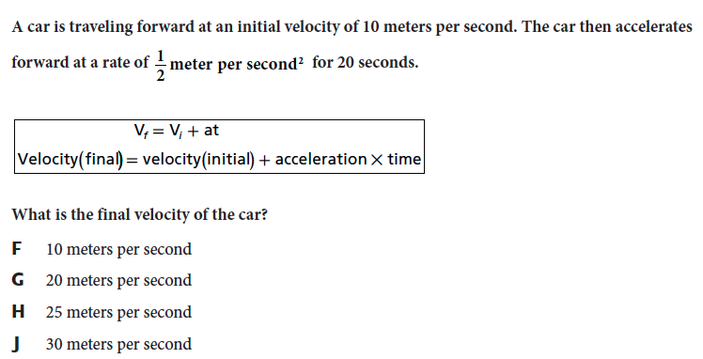
Now, you try!
Notes:
The answer is G.

Slide 10
Something to think about…
http://www.sciencechannel.com/tv-shows/head-rush/videos/head-rush-terminal-velocity.htm
Notes:
http://www.ducksters.com/questions/physicsvelocityanswers.php

