Slide 1
August 26, 2014
You must explain why your answer is correct.
Please write the page number in your book that supports your explanation.
Use the index of your book to help you.
Notes:
G

Slide 2
Chapter 13 Day 12 Lesson 3 Part 2
I can identify how Newton’s laws of motion relate to the movement of objects.
GLE: 0707.11.4 Investigate now Newton’s laws of motion explain an object’s movement

Slide 3
CHAPTER 13 LESSON 3
I can identify how Newton’s laws of motion relate to the movement of objects.
GLE: 0707.11.4 Investigate now Newton’s laws of motion explain an object’s movement

Slide 4
What You Will Learn
How net force, mass, and acceleration are related
What Newton’s second law says
What Newton’s second law looks like in real life

Slide 5
What Mastery Looks Like

Slide 6
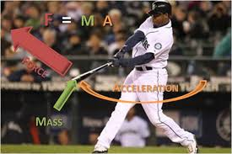
III. The Second Law of Motion
2nd Law of motion states that acceleration of an object depends on the net force acting on the object and the object’s mass.
Equation: F=m*a
http://science360.gov/obj/video/58e62534-e38d-430b-bfb1-c505e628a2d4/science-nfl-football-newtons-second-law-motion

Slide 7
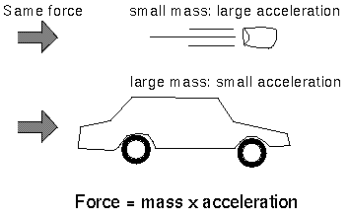
A. Acceleration and Mass
Why is it harder to throw a basketball than it is a baseball?
The mass of the basketball is larger than the mass of the baseball.
If the net force is the same, the acceleration of an object’s decreases as the mass of the object increases.
Example: The same net force causes the baseball’s acceleration to be greater than basketball.
Or, An empty backpack speeds up more quickly than one that’s full using same force.
https://www.youtube.com/watch?v=nO7XeYPi2FU

Slide 8
B. Acceleration and Direction of the Net Force
Acceleration is in the same direction as the force.
When you pull a wagon, it starts moving in the same direction as your pull. (your force)
When a tennis player throws a ball in the air, the ball changes direction after it is hit by a racket.
What other force is acting on the ball while it is in the air?

Slide 9
C. Acceleration and Net Force
Lifting a backpack – its speed depends on its mass and the force you exert.
Pulling upward quickly (using force), the speed of backpack changes quickly
Acceleration increases when the net force increases.
What happens if you pick up your backpack thinking it’s heavy, but it’s actually light?
https://www.youtube.com/watch?v=WzvhuQ5RWJE

Slide 10
Exit Ticket
How are acceleration and net force related?

